Slide 1
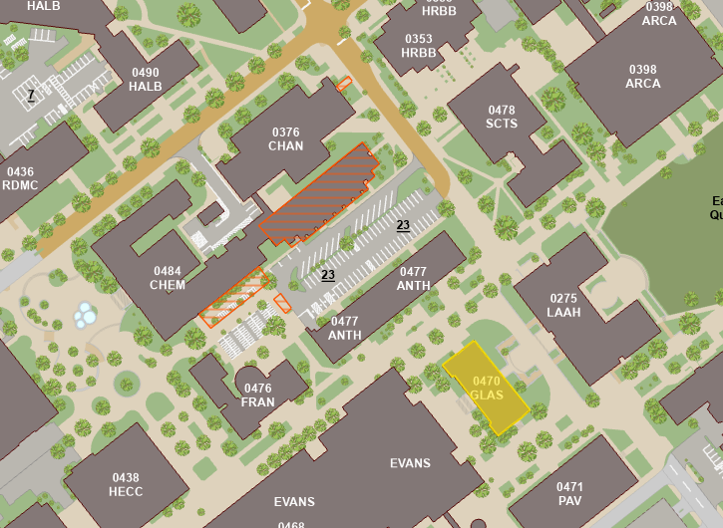
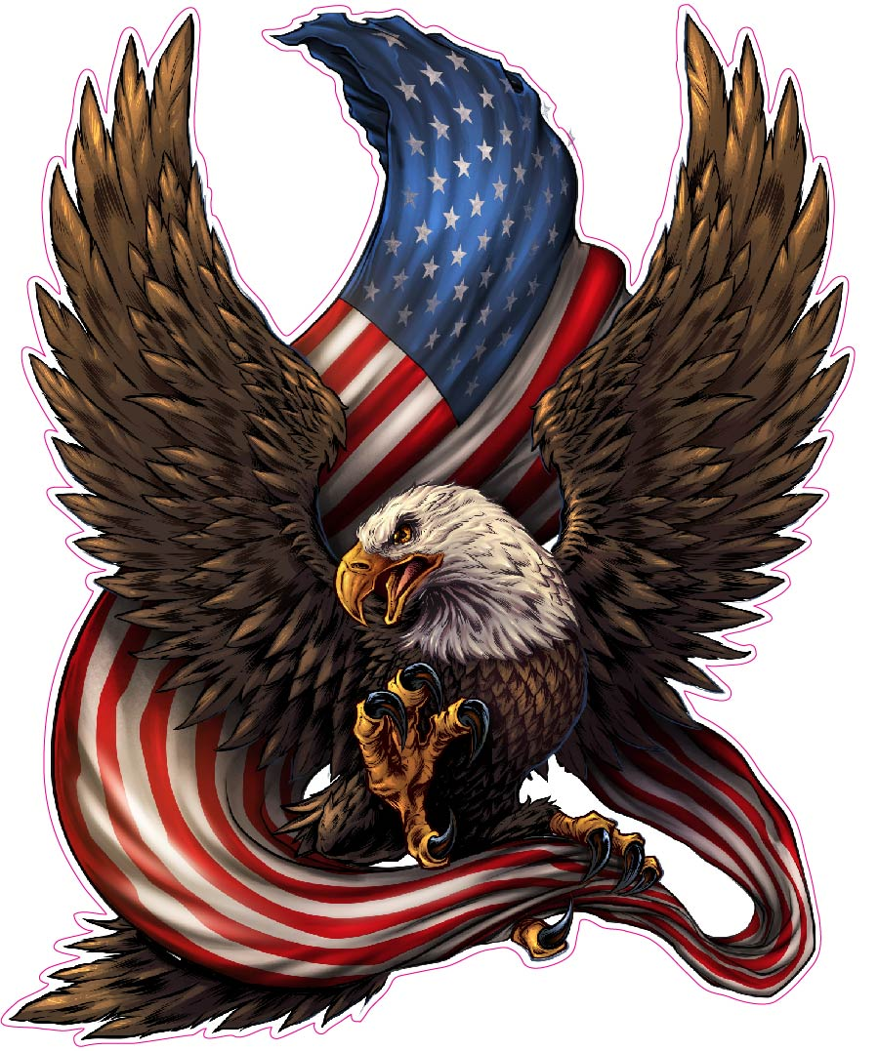
Course Info
Time: MW 4:10-5:25 PM
Location: Chem 100
Instructor: Dr. Lorien Foote
Office: GLASS 211A
Email: lfoote@tamu.edu
Office Hours
MW 10:20-11:20 AM
MW 1:30-2:30 PM
By appointment
Teaching Assistant: John Lewis
Office: GLASS 003B
Email: john-lewis@tamu.edu
Office Hours
TR 10:00-11:00 AM
Grading:
Assignment | Due Date | Max Points
Martin Essay Quiz | Sep. 4 | 25
Sledge Essay Quiz | Oct 30 | 25
Military Image | Nov 20 | 25
Sherman Quiz | Sep 25 | 25
Cordon of Steel MC Quiz | Nov 11 | 10
Soldier Comparison Essay | Dec 6 | 40
Midterm | Oct 9 | 100
Final | Dec 6 (3:30-5:30) | 100

Slide 2
Topics Covered:
Aug 19: Indian Warfare and Adaptation
Aug 21: Colonial Wars
Aug 26: American Revolution
Aug 28: American Revolution
Sep 4: Early Republic
Sep 9: War of 1812
Sep 11: National Expansion
Sep 16: The Mexican War
Sep 18: The Civil War
Sep 23: The Civil War
Sep 25: The Civil War
Sep 30: Reconstruction and Frontier Wars
Oct 2: War for Empire
Oct 9: Midterm
Oct 14: Early 20th Century
Oct 16: The Great War
Oct 21: Inter-War Years
Oct 23: World War II
Oct 28: World War II
Oct 30: World War II
Nov 4: Atomic and Cold War
Nov 6: Korean War
Nov 11: Vietnam
Nov 13: Vietnam
Nov 18: Vietnam
Nov 20: Recovery and End of Cold War
Nov 25: Gulf War
Dec 2: War on Terror

Slide 3
Overarching Questions:
How have Americans applied the concepts of civilization and mortality to how they practice war? How have Americans justified guerilla war and hard war against civilians?
How have Americans conceived of the citizen-soldier vs. the professional soldier?
How have social and cultural forces shaped American military institutions and how Americans practice war? What role have wars played in transforming social life in the United States?
How have military theories, strategies, and tactics changed over time? What factors have contributed to the changes?
How did the enlisted soldier experience duty and combat? How did that experience change and remain the same across time?

Slide 4
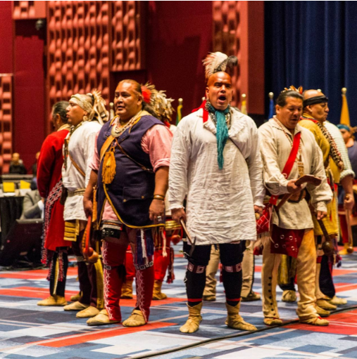
Indigenous Wars
Characterized by conflict between 2 societies with different military cultures
Native Military Culture
Cause For Wars among natives:
Revenge against another tribe for killing one of their own
Taking captives to replace that lost member
Native battle Tactics
Focused on ambush to surprise enemy and get captives
Parties usually consist of a few people with good senses
Communicate with accurate animal sounds
Attack with tomahawks and knives
Masters of concealment
Hand-to-Hand combat
Important to natives because the only way to become a “man” was to participate in hand to hand-to-hand combat
Torture
Natives viewed resisting torture as manly. Dying while resisting torture was a great honor.
Europeans viewed torture as savage.

Slide 5
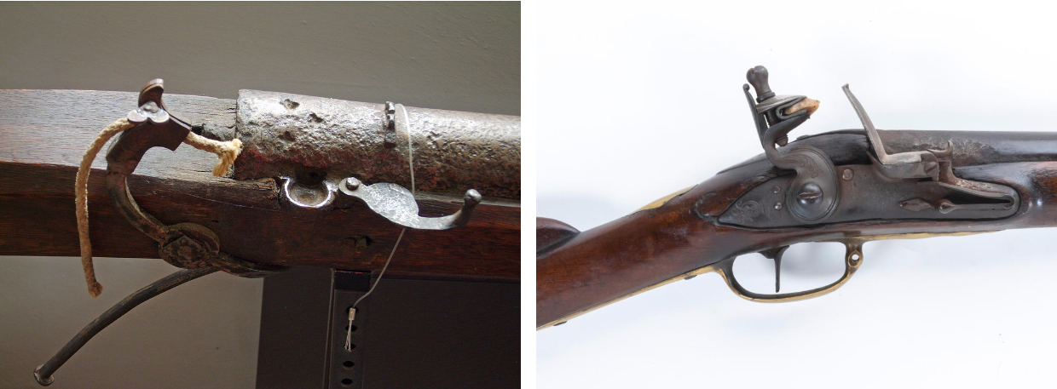
European Military Culture
English military culture is characterized by a fear of standing armies
Standing armies were viewed as tyrannical and against liberty
Instead, militias were used, and war was supposed to be fought by the people
Every man would participate in drills every other month
English line tactics
Men would stand shoulder-to-shoulder and fire timed volleys at the enemy to instill shock
A lot of precision and training were necessary to perform effectively
Common weapons during this time were the matchlock, and later, the flintlock
Colonial adaptations
Tidewater War (Virginia, 1622-1632)
On March 22nd, 1622, Natives ambushed settlements in Virginia, killing 25% of the population.
Colonists would march into the woods asking for battle but were only met with more ambushes and laughter.
Made the colonists realize they were vulnerable to native tactics
Colonials trying to adapt
Create strongholds and defenses to protect people
Natives would not put the defenses under siege, leading to a waste of time and resources
Create a defensive line and forts
Natives could easily sneak through the line with concealment
Create rangers
Semi useful, could report whereabouts of natives

Slide 6
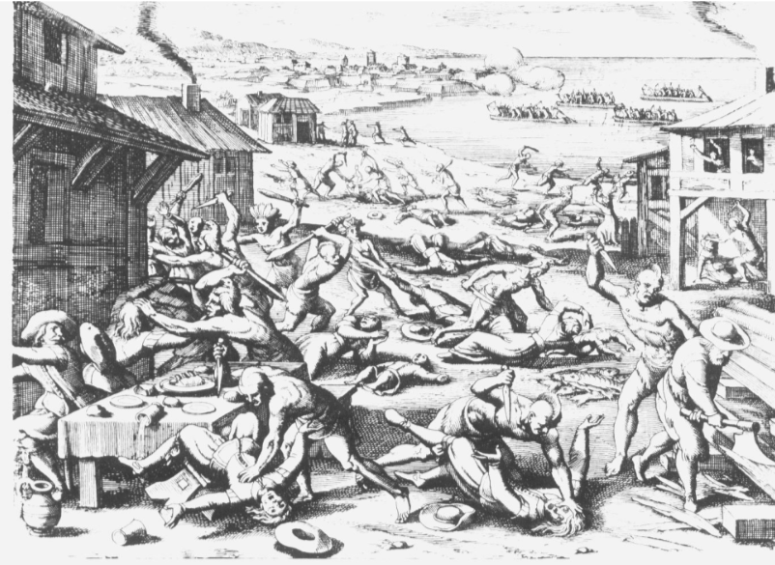
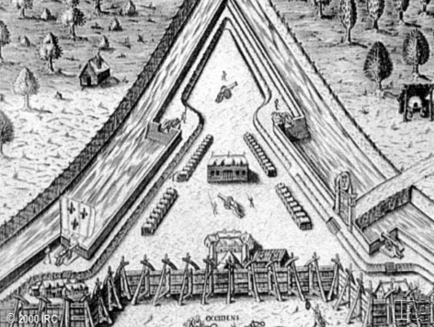
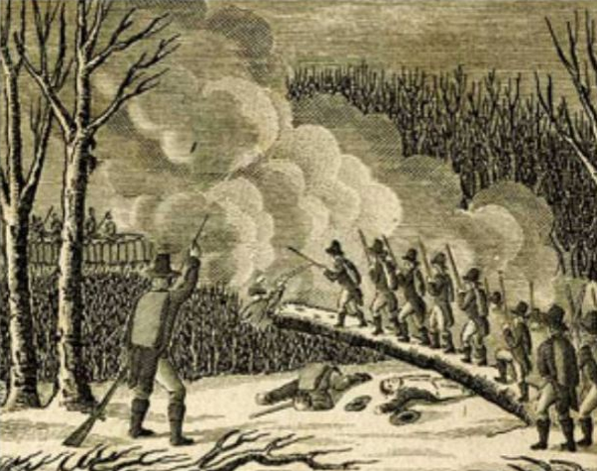
Successful Adaptations during Tidewater War:
Create alliances with other natives to have them reveal settlements to the colonists
Use this information to destroy food supplies, crippling natives
Use ambush tactics of their own by hiding behind trees and firing
King Phillip’s War (New England, 1675-1676)
Bloodiest war in American history (by percentages)
40% of natives died, 5% of English colonists
Started with the devastation of New England towns by the Wampanoag
English use their new tactics to go and destroy native towns
Battle of great swamp (1676)
Fearing an attack next year, the colonists made a preemptive attack on the natives during the winter
The entire village was burnt to the ground

Slide 7
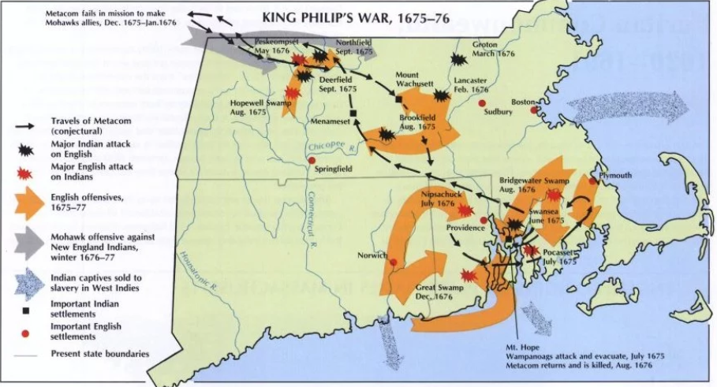
Colonial Adaptation: Benjamin Church
Benjamin church got permission to make a militia that fought like the natives.
The ambush tactics used were very successful
Native Adaptation: Volley fire
During one example, Benjamin Church’s group encountered a native unit that ambushed them with volley fire.
Outcome from the war
Many accounts of the war were created for the time.
This was the start of the colonists viewing themselves as Americans
Led to the natives being viewed as savages
Significance to question 1 of the overarching questions
The enemies were savages, the only way that they could be beat was to adapt their savage tactics

Slide 8
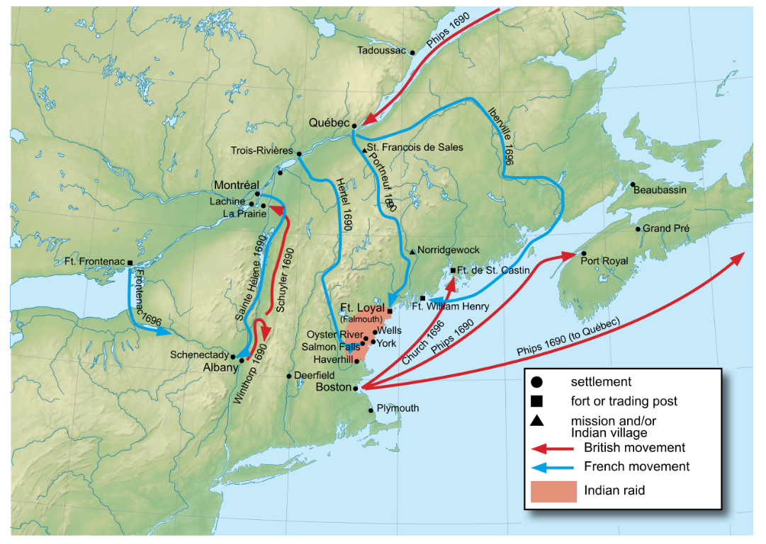
Colonial Wars
Characterized by the sowing of discontent between colonists and the British
British advantages over the French
England had the most dominant navy in the world
The British colonies were much more populated and developed than the French ones
British were focused on agriculture while French were focused on fur trading
King William’s War (1689-1697)
French and Natives strike New England and New York
Leads to colonists meeting to develop a plan to attack Canada
Create a plan called “The Blueprint” with two groups
One would be land based that would set out from Albany, head North past Lake Champlain, and strike Montréal
The other would be sea based, head out of Boston, go through the Gulf of St. Lawrence, go down the St. Lawrence River, and strike Québec
The blueprint couldn’t be used due to a lack of resources
The rest of the war consisted of border raiding
The treaty reinstated the status-quo

Slide 9
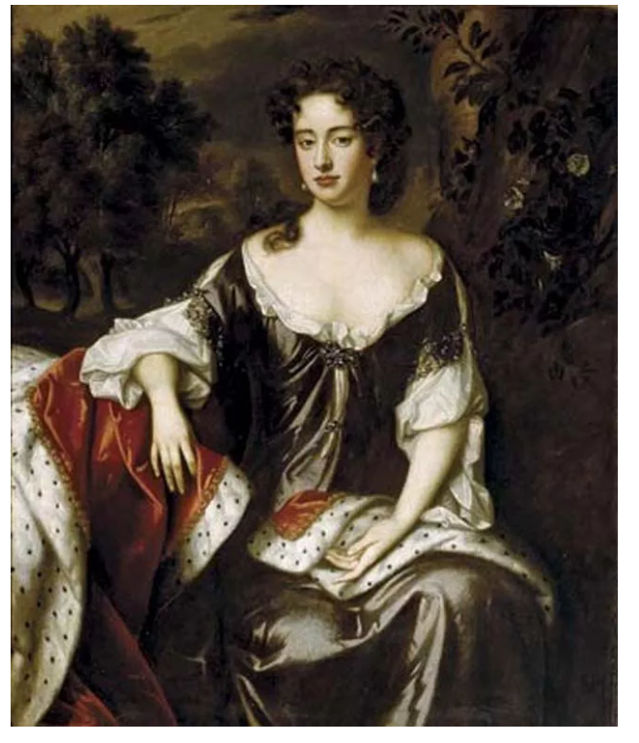
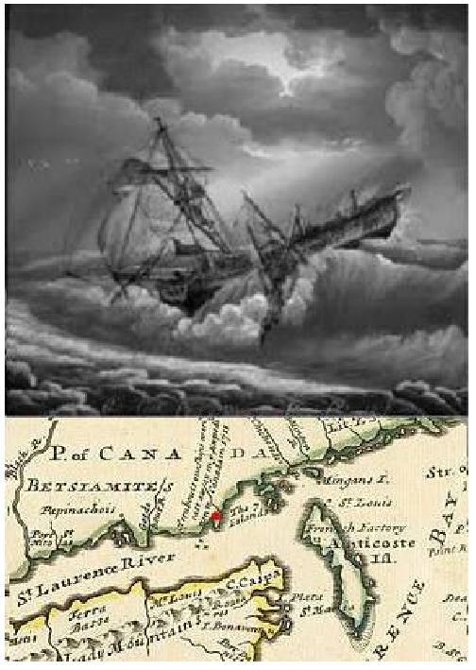
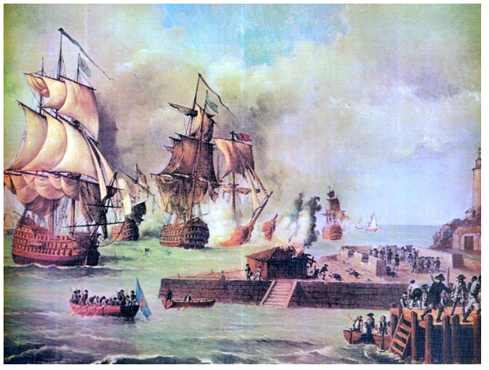
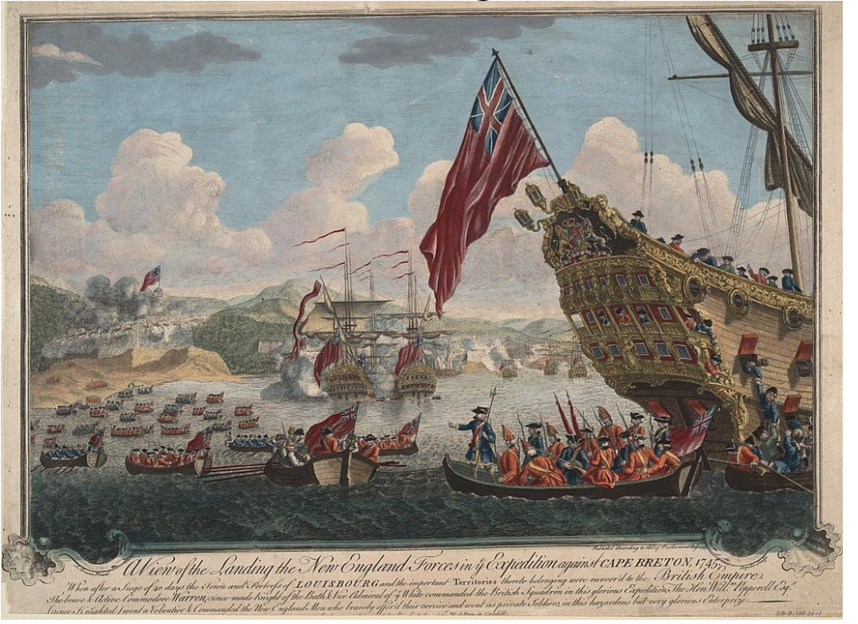
Queen Anne’s War (1702-1713)
Colonists wanted help from the British to go through with their blueprint, but the British cared more about Europe
However, in 1709, the British told the colonists they were planning on coming to help.
2,000 militia men gathered waiting for the British, but the British ended up canceling the expedition
In 1711, another expedition was planned and to be led by Hovenden Walker
The sea group consisted of 9 ships of war, 60 transports and 12,000 troops
The planned was started, but a storm ravaged the sea group. This led to 8 transports running aground, killing ~1,000 men
Walker cancelled the expedition after this.
The colonists were mad the British turned around, and the British didn’t like the colonists
King George’s War (1744-1748) (France and Spain)
British put together a large task force to attack Cartagena (Colombia), and the colonists sent some men to help
The British treated the colonists poorly, giving them the worst supplied and making them do fatigue duties (dirty work).
On top of that, the expedition failed.
Near the end of the war, the colonists planned an attack on Louisburg, a large fortress that could attack ships going to the Gulf of St. Lawrence.
They could do this because the fort was lightly defended at the time.
The colonists captured the fort and held it until the end of the war
However, in the treaty, they had to give it back to the French.

Slide 10
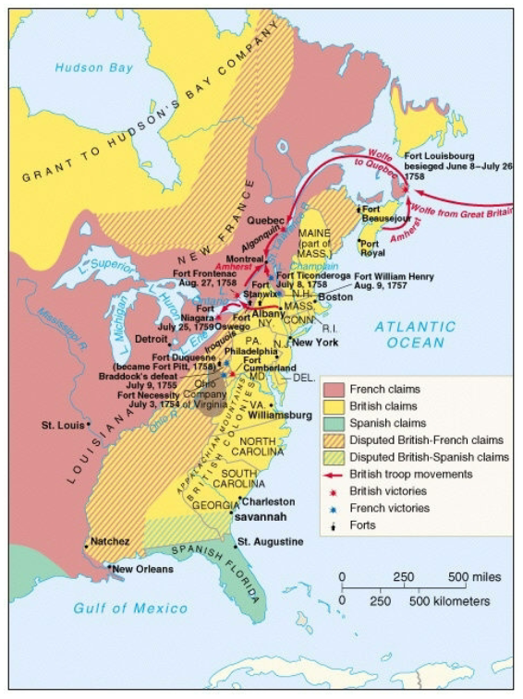
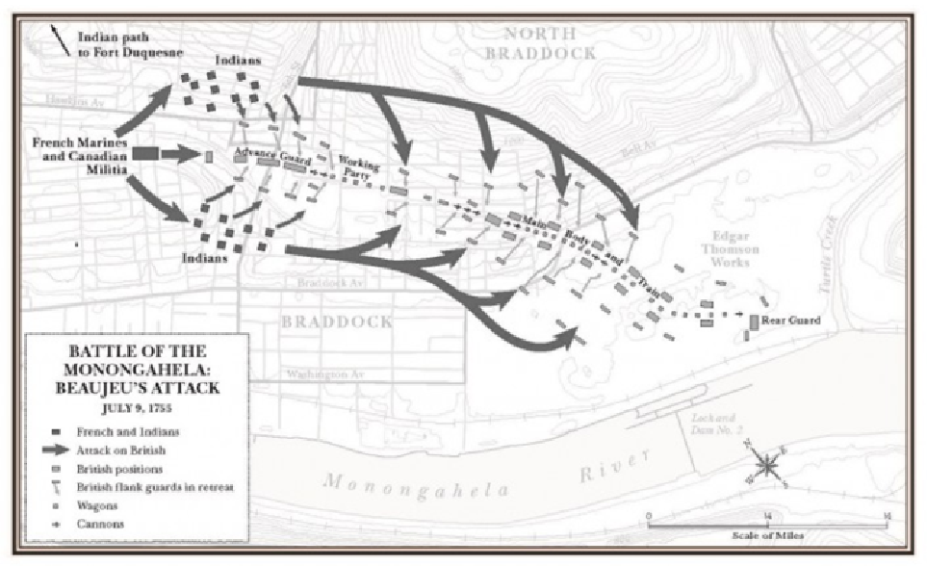
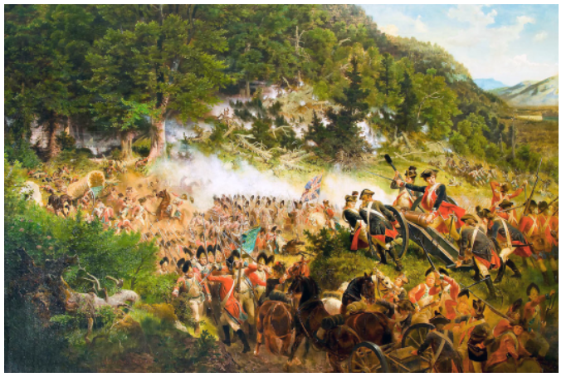
French and Indian War (AKA The Seven Years War) (1754-1763)
Started when a group led by George Washington, that was supposed to scout French forts, engaged a French force. One of the Indians that was with the British killed a French man and humiliated him.
The first major British attack on the French forts came with the attack on Fort Duquesne (Pittsburgh). It was led by Edward Braddock
He led a group of 2,200 soldiers (mostly British)
The whole reason this attack could happen was because Benjamin Franklin got a bunch of horses for them to use.
Braddock sent an advance column to attack the fort.
Battle of Monongahela
Due to his Indian allies, French commander Daniel Beaujeu knew it was coming.
He surprised the British by having the French attack the front, and his Indian allies attacking the flank.
The British were caught off guard and sustained heavy casualties. They tried to make formations they would use in Europe, but it wouldn’t work.
The Americans scattered and hit behind rocks and trees. They covered for retreating Brits.
This led to the Americans thinking they were better fighters than the British. This battle was taught to young colonists, further seeding bad blood between the two.

Slide 11
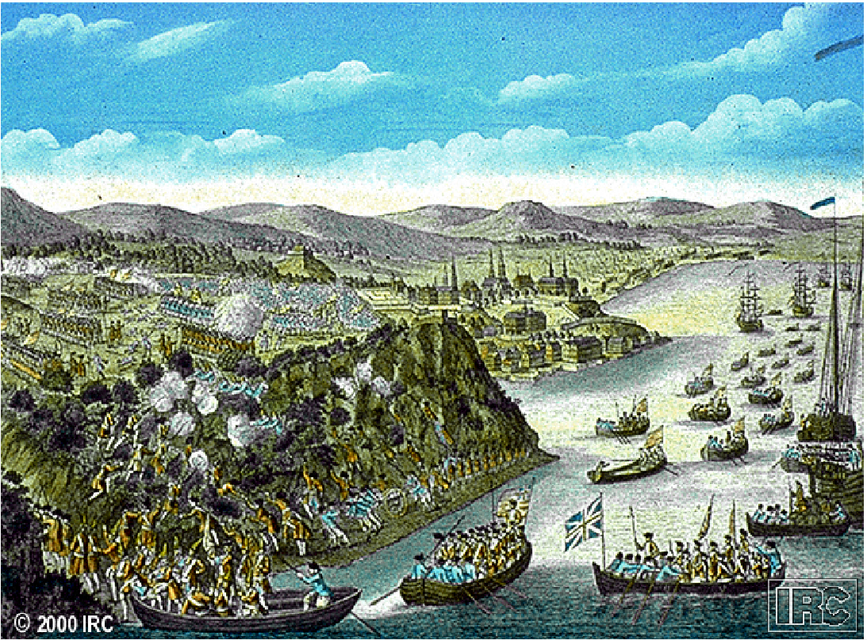
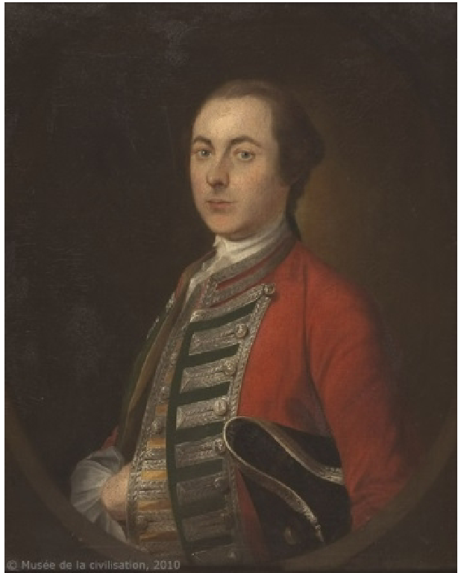
British turning around the war:
William Pitt became prime minister halfway through the war, and had a different strategy to win
He would finance the Prussians in Europe but send the British military resources to North America.
He also wanted to use the blueprint to attack Canada
His first course of action was to blockade Canada, and that worked.
James Wolfe was sent to lead the attack on Québec
1/4th of the navy was sent, and 8,500 men.
He had troubles attacking The fort in Québec and was running out of ideas. However, an American POW escaped the fort and told him of a secret path they could take to attack the city from behind
Wolfe used this information, and at night, transported his troops to the lakeside, and had them all climb up a cliff to attack the city.
At morning, the Battle of the Plains of Abraham took place
The Marquis de Montcalm saw them in the morning and sent his troops to engage them.
The French lost embarrassingly, as most of their troops were undisciplined.
Despite this big win, British and colonial relations were still strained
Throughout the war, the British sent letters back home saying the Americans were undisciplined and cowardly
They would not head into Canada, because their contracts said they were enlisted for 3 months in their homeland
Americans were mad because the British professional soldiers had to stay in their homes. They were low-class and caused trouble.

Slide 12
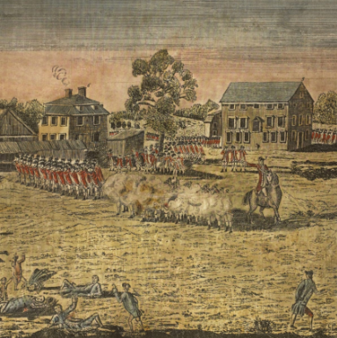
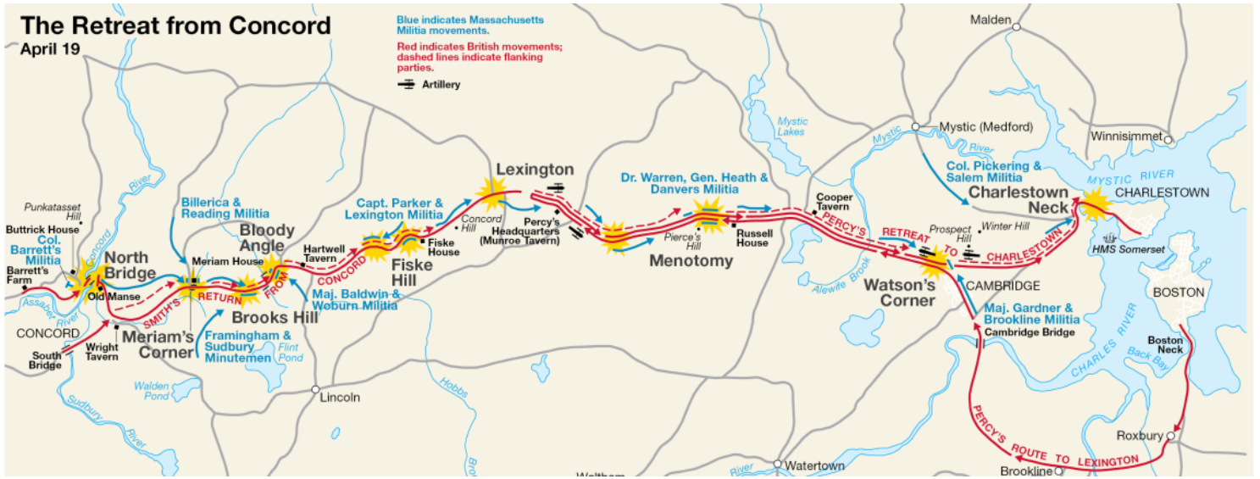
American Revolution: Part 1
The composition of the revolutionary army and Washington’s strategy
Start of the war characterized by local military decisions
Colonists don’t have a decided goal yet, and the British don’t believe they will have to have a serious conflict with the colonists
Battle of Lexington and Concord
Thomas Gage hears of militia stockpiling of supplies in Lexington and Concord.
Heads out from Boston with plans to take the weapons and arrest the leaders
When the British get to Lexington, 70 militia men are there to meet them
Initially, the man in charges tells the rebels to disarm and leave
British military officers are cursing at the militia men
Eventually, someone fires, and fighting ensues
British achieve their goals and head to concord
Other militia men hear of what the British have done, so they decide to attack them (minutemen)
On the way back from Concord, British are under constant attack from the Colonists.
Called the “Second battle of Monongahela”
Eventually, the British find their way back to Boston and stay there
The colonists can’t take the city because there’s only one way in or out.

Slide 13
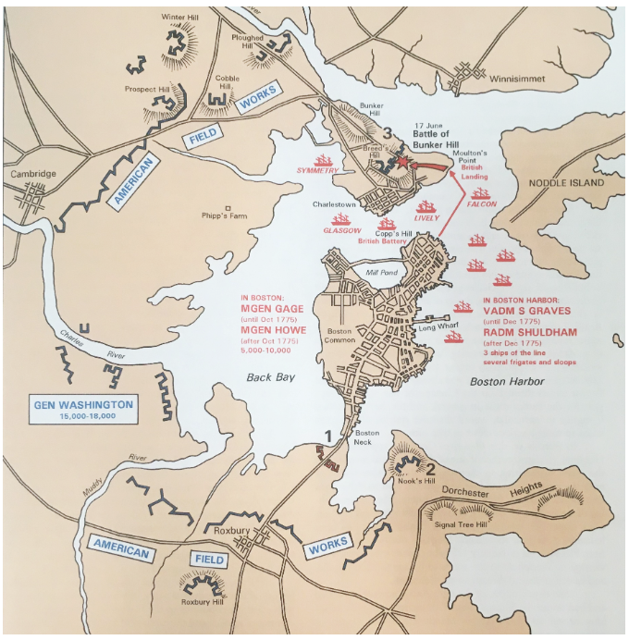
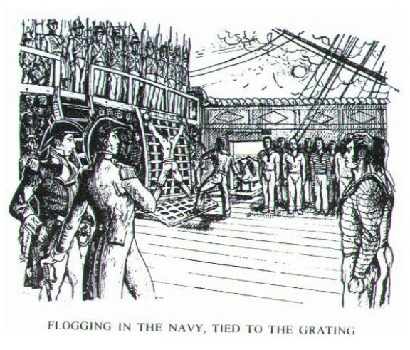
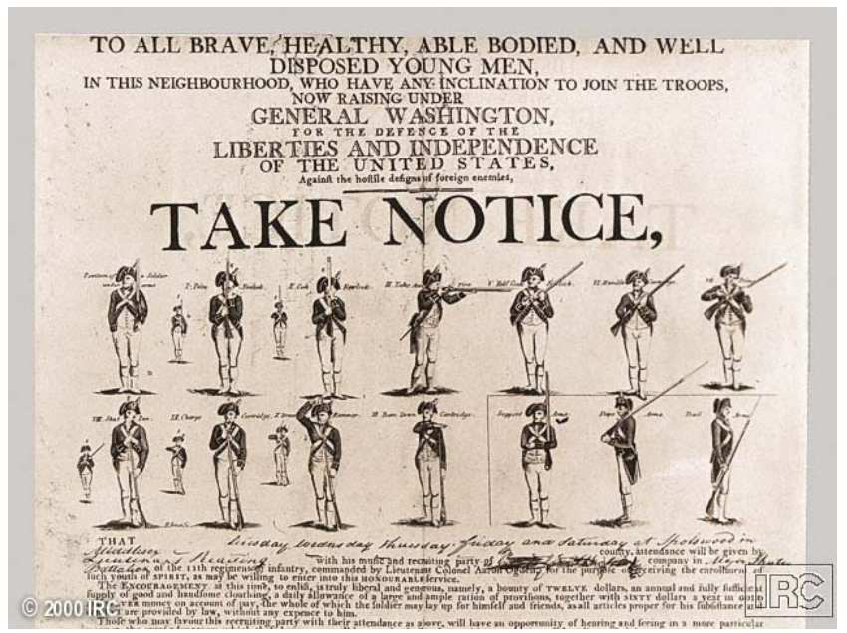
Unable to take Boston, Ethan Allen and a militia decide to attack Fort Ticonderoga to get supplies
Meanwhile, the Continental Congress is underway, and they want to create a more unified response against the British and not just rely on whatever the militiamen are doing
Decide to make Washington the leader of this army
Initially composed of the Massachusetts Militia, but forces from Pennsylvania, New York, and Virginia added.
Due to American suspicions of central authority, the only way to get funds was by the states asking for money
This led to soldiers not being paid and not getting good supplies
Continental army composition:
Officers are wealthy upper-class while enlisted men are lower-class
Very diverse. Many black men, Germans and Irish
Officers come from gentlemanly class
They have etiquette and honor
Honor in this time is seen as your social self worth
If you are not respected by your peers, you have no honor
While a common punishment for disobedient enlisted men would be flogging, a punishment for an officer would be the stripping of rank (social exclusion)
Washington basically adopts the British articles of war, in which, officers must act gentlemanly

Slide 14
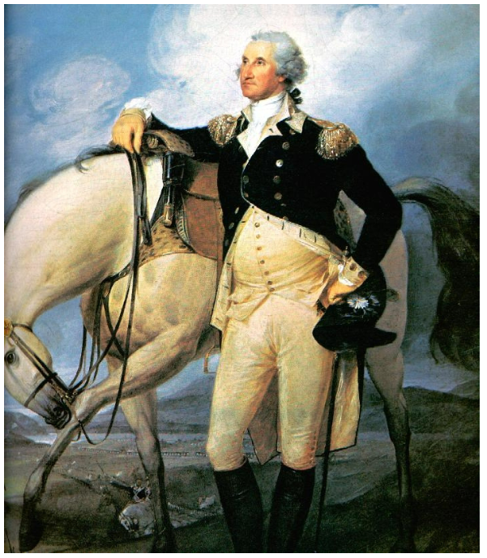
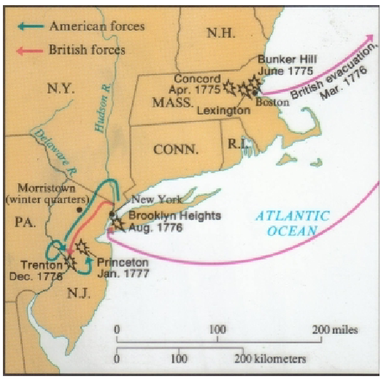
State Militia
Mostly upper class
Officers are elected, so they treat their men well
Fight in an unconventional style (ambushes and firing from behind cover)
Washington’s Strategy
Initially, Washington wanted to make a conventional army that fought with linear tactics
This was to try and convince Europeans that America was civilized, so they could get funding
Tries to defend long Island, but that fails miserably
Troops are untrained and undisciplined
New strategy: Erosion
If he keeps the army alive and, in the field, the British can’t win the war
Try to get the British to lose the will to fight
Inflict small casualties on the British for an extended period while avoiding large battles
To make this work, he create a spy network to get whereabouts of British movements
Some issues with this strategy:
Keeping morale of troops and keeping morale of citizens
Dec 76’: 3,000 troops in NY with bad morale. Just lost long island
Spy network notifies Washington that British mercenaries are hunkering down in New Jersey for the Winter

Slide 15
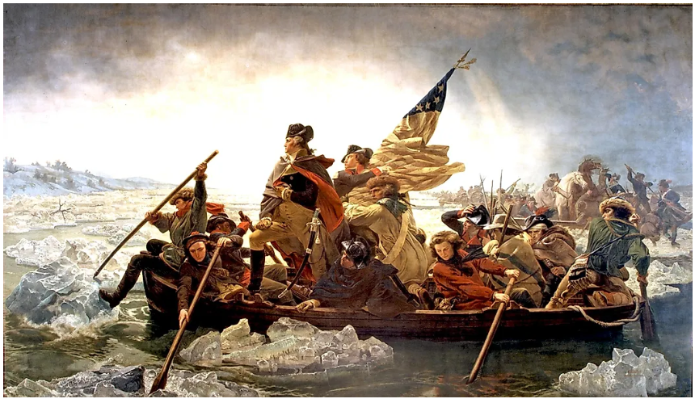
Washington crosses the Delaware with his troops and completes a route at Trenton. He quickly retreats across the river again
Spy network reveals that 6,000 troops are looking for his army
So, he crosses the river again and takes out a small detachment of that 6,000
British (lack of) strategy
Switching between two main options: being benevolent and destroying rebels
No command structure, causing big problems
Saratoga
Edward Burgoyne develops a strategy to eliminate the rebels: use their blueprint in reverse
Plans on heading down towards Albany from Canada and having William Howe go North from New York City
Howe does not go North from New York City, instead going to Philadelphia
Burgoyne ends up taking a long time to head South. This is due to his own slowness and rebels blocking the path by destroying the path
This leads to him sending out detachments to forage, which get intercepted by militia men
Knowing that Saratoga is more important than what Washington is doing, he sends his best units North to help. (Horatio Gates leads this)
Gates engages Burgoyne and militia surround him
This leads to Burgoyne surrendering

Slide 16
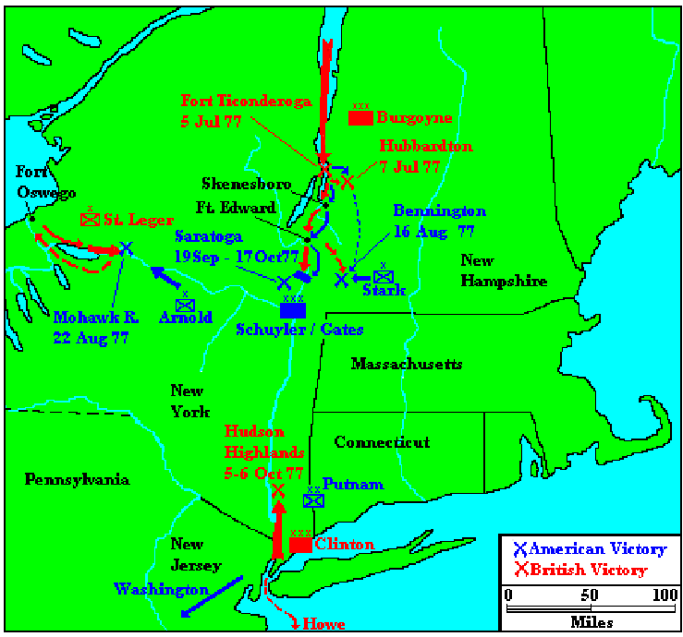
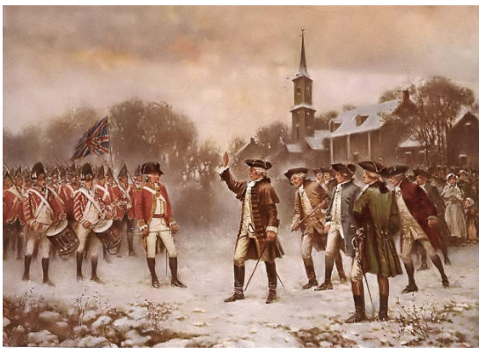
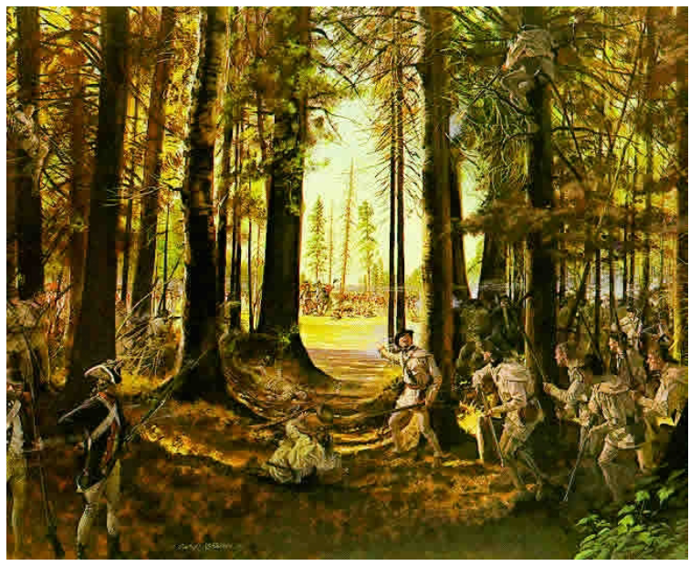
Consequences from Saratoga
Support for the war in England plummets. After 2 years, there is no progress
Convinces the French that the Americans can win
The French agree to fight Britain until the colonies gain independence
Turns this into a world war for the British
French navy comes to help the Americans
Convinces Washington he can risk a large battle with the British

Slide 17
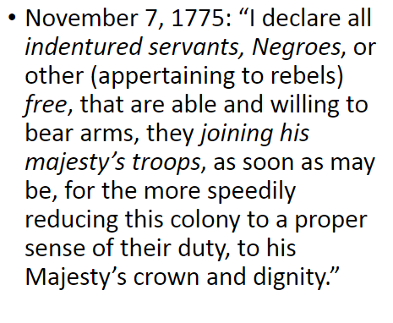
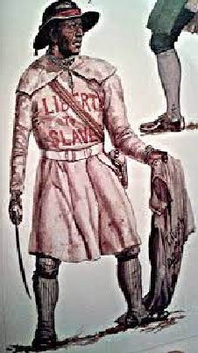
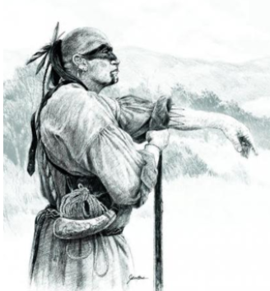
American Revolution: Part 2
Civil war and Nathaniel Greene
Loyalists
Patriots not only have to fight the British, but loyalists, blacks and Natives too
Dunmore’s Proclamation stated that all slaves and indentured servants that fought for the British would be free after the war
Cornelius Titus – Leader of Black Brigade
Took up on Dunmore’s proclamation and lead a group of slaves, indentured servants, and natives
Started a guerrilla war in Monmouth county New Jersey
Guerilla war is when a small groups of people use unconventional tactics to disrupt enemy operations
Cherokee war of 1776
Dragging Canoe sees that the revolution is occurring and knows this is his chance to defend themselves against settlers
Gets many villages together to destroy settlements in Virginia, North Carolina, South Carolina, and Georgia
Major successes in South Carolina and Georgia
Patriot campaign sees militias stop a lot of the progress Dragging Canoe makes
In the end, the Cherokee are forced to cede more land

Slide 18
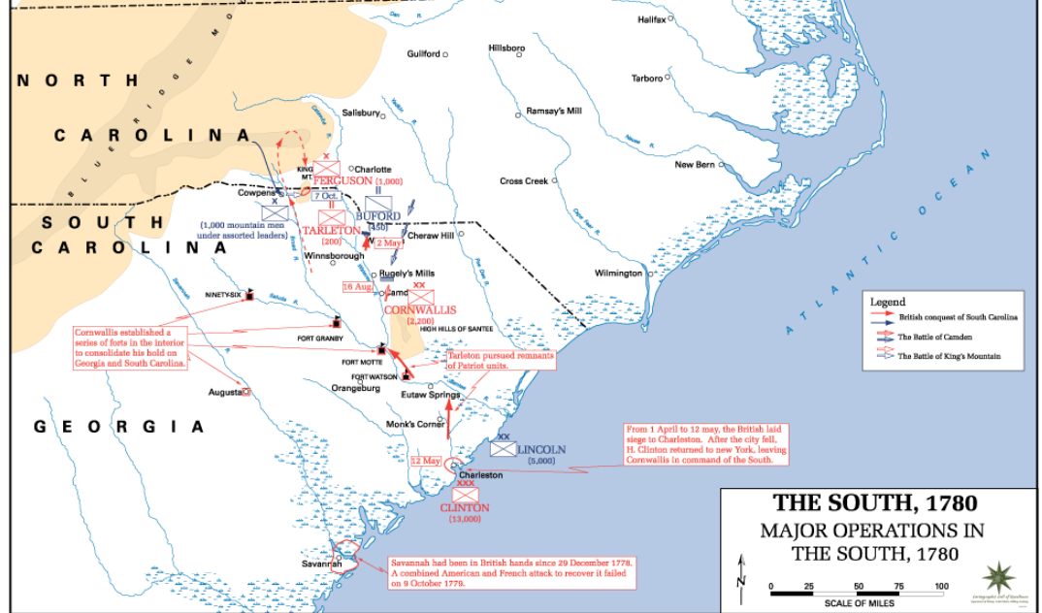
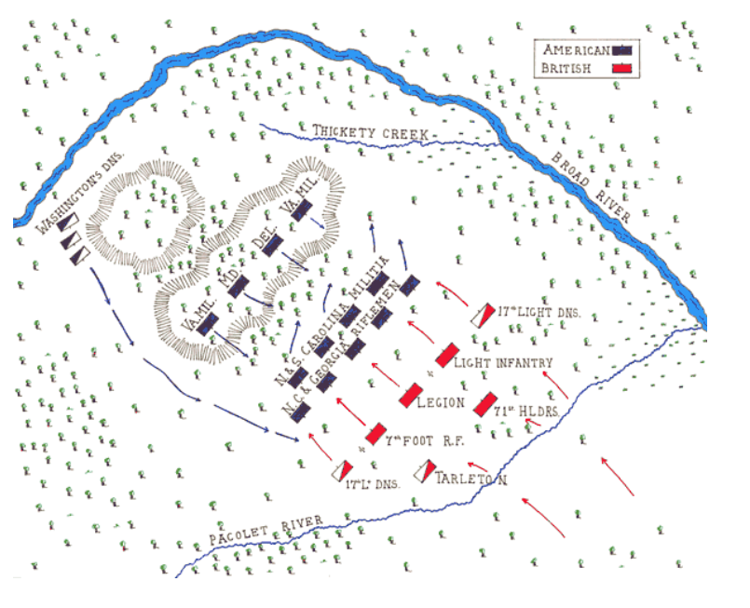
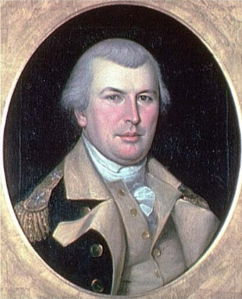
British shift focus to the South in 1780
Captured lands and forts in South Carolina and Georgia
Many British soldiers and officers did bad things because they were mad the war had gone on so long
Many patriot Guerrillas were present in these states
Nathaniel Greene
He was Washington’s quartermaster
When Washington promoted him, he was mad, but he accepted anyway
His strategy to get rid of the British
Try to coordinate with the guerillas as well as possible by encouraging the British to send out small detachments
He did this by splitting up his forces, which was contrary to the military strategy at the time
This led to the British splitting up to look for him, often sending out small detachments.
Like a crab; move as fast in one direction as the other

Slide 19
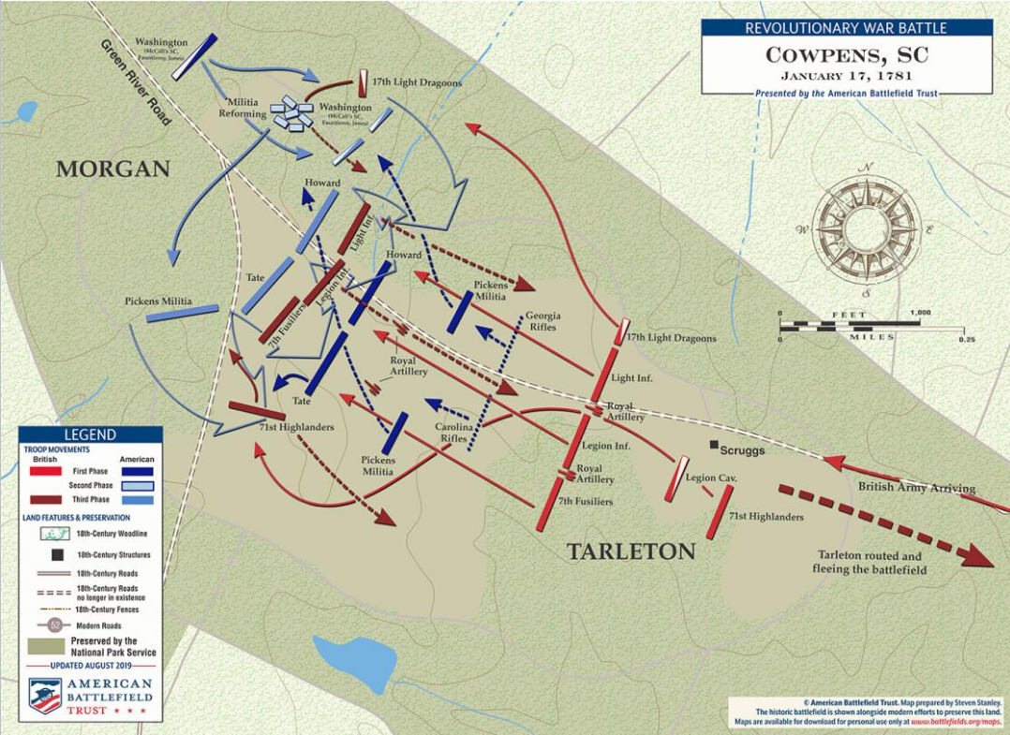
Daniel Morgan and the Battle of Cowpens
Daniel Morgan was at the battle of Monongahela
As his time serving under the British, he was lashed 100 times
However, the lasher missed the last one. This made him say “I’ll give the last one back to the British”
He had 1,000 troops under his command
Both continental trained troops and untrained militia troops
Morgan’s battleplan for Cowpens
Have 3 lines of troops: a row of sharpshooters to try and kill officers, a row of militia men, and a row of his continental troops
Battle of Cowpens
Tarleton's British army attacks Morgan
After the British get close, the sharpshooters fire and retreat to the 2nd line
The second line fires 2 volleys and retreats
British dragoons follow the militia men
Morgan’s dragoons cover the militiamen, so they can recover
British line and continental line start fighting
Tarleton sends in his highlanders, so a patriot general orders the men to change position
Some men think this is a retreat order, which leads the British line to do a full attack
Continentals regain organization and with the help of the militia men, they envelope the British
The British suffer 90% casualties

Slide 20
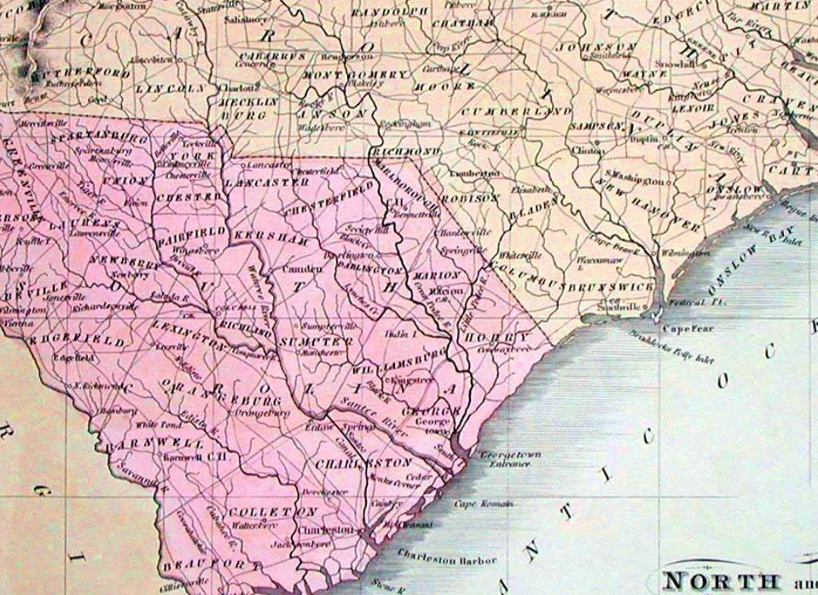
After Cowpens, Greene orders his armies to concentrate so they can retreat to Virginia
This causes Cornwallis, who was the British commander, to chase him
Due to Morgan’s time as a quartermaster, his army is more organized and able to outrun the British
This causes Cornwallis to burn their baggage to move faster
At this point, Morgan knows he has a strategic victory, even if he can’t win the battle
Due to the loss of supplies, the British need to forage for food, leaving them open to attacks from the guerrillas
Morgan is still able to move faster than the British, and he eggs the British on by purposefully going slower, to give the British hope
Eventually, they fight in Virginia and Morgan loses (Guilford Court House)
However, the British suffer massive casualties. Due to their lack of supplies, they need to travel back to the coast to get aid from the Royal Navy

Slide 21
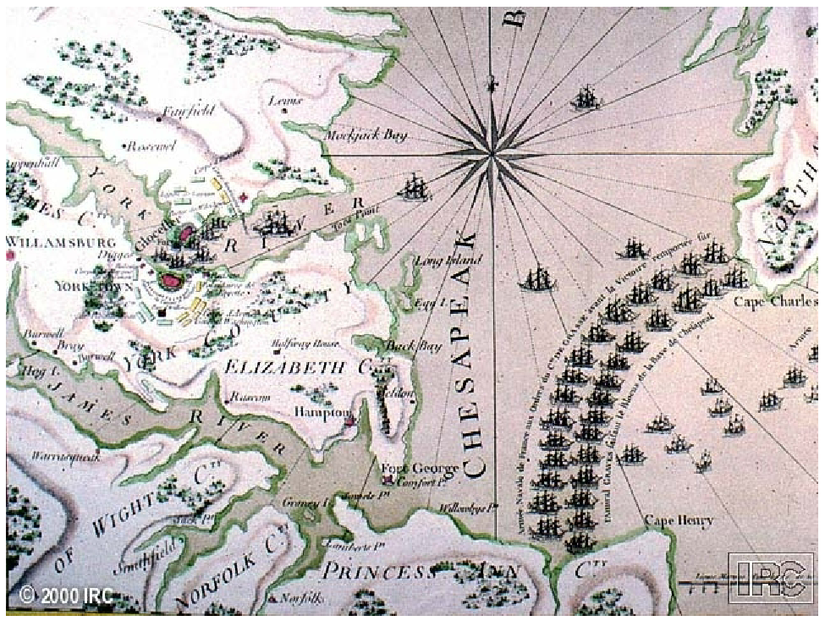
Ending to the war
Cornwallis retreats to his base at Yorktown
George Washington sees this as his chance to engage the British in a large conventional battle
Coordinates with the French to have the continental army arrive at Yorktown at the same time as the French navy shows up
Works perfectly
Yorktown (1781)
Washington arrives from the North; 7,500 French and 8,500 Americans show up.
French fleet defeats the British at the battle of the capes
British lose because of mixing up signs, causing them to be forced from the area
Now the French are blocking the bay, surrounding the British
Cornwallis surrenders shortly after the siege begins
British surrender because they were no closer to winning the war 8 years ago than they are now

Slide 22
Joseph Plum Martin
Why did Martin serve in the Continental Army?
Initially, Martin did not want to be in the service, but as he got older, he became more interested in it, and thought not serving would make him cowardly. Also, he thought of himself as a patriot and wanted to prove it by serving in the army. He was so determined to join the army that he didn’t care that there were 15,000 British troops stationed nearby; he would have enlisted as fast as if there were only 1,500.
What are the different categories of hardships, or “sufferings,” that soldiers in the American Revolution experienced? How did soldiers try to mitigate these hardships?
The main hardships that plagued the soldiers were starvation and sickness. Joseph even got smallpox, dysentery and boils back-to-back Other soldiers and doctors usually would be kind to help them. For example, when Joseph got sick in the 76 campaign, his soldier friend made food for him to feel better. Joseph was on the other end of it too. During Kipp’s Bay, a man he knew was sick and wanted to just stay there and die. However, Joseph motivated him to go back to find the company and save his life.
However, a lot of the time, there was no reprieve that the fellow soldiers could provide to help with starvation and the cold. The hunger usually got solved by eating civilians’ food whenever they had the chance (Like when someone trying to hide the locations of some people who destroyed the commissaries took them to a barn) or eating disguising brittle food (Like when joseph tried to broil some food, but it had gone so bad that he had to spit it back up).

Slide 23
What types of military actions and duty did Martin participate in? What do his descriptions tell us about the perspective of the enlisted soldier in the Revolution about tactics and duty?
The first engagement Joseph found himself in was Kipp’s Bay. During that “battle” , most of it was a retreat after his company found themselves in the line of fire from some Royal Navy ships. The retreat showed how little information the soldiers had to go off, and how the soldiers have a strong connection between themselves and their friends.
Another battle Joseph was in was the defense of mud-island. During that battle many of the people around him perished gruesomely from the constant barrage of British cannons. As shown with the man who went to raise the flag, if you wanted to keep your life, maybe the best thing to do was to stay out of danger as much as you could; even if it meant being a lousy soldier.
Later in the war, shortly after Valley Forge, Joseph and his detachment were attacking a British position in the Summer. In that engagement, Joseph showed good resolve and responded promptly to the commanding officer. He seemed to have good knowledge about the surrounding action, but I don’t know how much of that is hindsight.
Joseph also participated in the battle of Yorktown. By this time, he had become a non-commissioned officer in the Sappers and Miners corps. Throughout the duration of the battle, he was able to give detailed accounts of the stages of the battles and the movements of other groups of soldiers.
What are examples that Martin gives of soldiers’ (including his own) poor behavior in battle, guard duty, and as sentinels? What is his perspective on this behavior and performance?
At the beginning of the 77’ campaign, he is sent off to guard and the officer in charge had a visiting party to check on the sentinels. Some soldiers were found sleeping, getting milk from cows, or just not doing their job. Joseph thought he did a good job, but in the morning heard of a story of a soldier that just saw the countersign and did no other checks; he knew it was him. While Joseph didn’t seem to have any strong opinions on the others who were caught slacking, he was ashamed of himself and his poor performance.
There were multiple times in the book, once at Schuylkill, and another when practicing with Baron Von Steuben, where the soldiers were given too much to drink on an empty stomach and got drunk. Joseph remarks in the first case that they were lucky to not be attacked by the British in their drunkenness. During these experiences he seems to be worried by these actions but does find them humorous.
Another instance came shortly after the practice, during guard duty. Joseph found him self, and his friends bored, so they decided to climb trees. During this behavior, Joesph fell off a tree and knocked himself out (?) . While he didn’t have any reflections on the behavior, he did state at the beginning of the section that had he been found by an officer, he likely would’ve been dismissed from the army.

Slide 24
What does Martin think about the officers in the Continental Army and militia forces? Why?
In general Martin respects them but doesn’t see them as that great of people. He has multiple encounters with one officer who threatens to kill him, once for stealing, and another time for not fully helping him with a gate. He also seems to see that they don’t care too much about the conditions the soldiers have to go through, with the cold and starving. In the mud-island defense, he must hide from the commanding officer when trying to get warm during the siege. Also, whenever some officers get in a fight during the 78’ campaign, he remarks that everyone loves to see officers' fight. Showing that he probably think they overstep their power a little too much and resents their better living conditions.
However, throughout the book he makes notes of officers that he likes, such as Colonel Stewart, who helped break up the 80’ mutiny
What examples does Martin give of insubordination and mutiny against officers?
In the 79’ campaign, the winter was characterized by the officers getting to sleep in nice homes in the village nearby, and the soldiers mostly had to fend for themselves. When they got to the location, the soldiers had to spend the night in the rain, and the officers didn’t help them. Throughout the time the soldiers were there, the officers constantly promised an improvement in conditions, but that never happened. Joseph and his peers dealt with the cold and starvation with no help. Soldiers would break a martial law, where they would fire a shot in camp, and the officers had to come and find who did it, but they never could. Due to this mutinous behavior, the officers allowed the troops to go home for the rest of the winter
In the 80’ campaign, during the Spring, the soldiers were nearly starved. This caused them to disobey their orders and parade around trying to get them to give them food. They tried to get soldiers nearby to join them, but only ended up stabbing an officer. In the end, Col. Stewart helped them get the provisions they wanted from the officers.
What is Martin’s perspective about courage and cowardice?
In the beginning of the book, we get a good look into his view, as he went into the army because he didn’t want to be a coward. Throughout the book, he doesn’t explicitly say anything about bravery or cowardice, but through his actions you can tell he is a brave man. Never, throughout the book, does he not do something with the reasoning being “I was too scared to do so”. In all the battles and minor engagements, he fights in, he never runs away out of fear. When he is caught by a group of refugees after getting stuck, instead of giving into the refugee’s offer of not harming him, he runs away knowing full well they could shoot and probably kill him. When he comes back from his visit from his home in 81’ he finds out his troop has left him for Virginia. His Captain suggests waiting for him and they could head down together, but he wants to be with his men and give them support. The only time he does show a slight of cowardice is during the mud-island siege, where he doesn’t volunteer to raise the flag. This ends up being a good idea and suggests that he is brave—within reason.

Slide 25
How does Martin describe the interaction and relationship between soldiers, civilians, and women?
During his foraging journey of 78’, most of the civilians were very kind to the soldiers, even if they had the power to take their property for the army. One family in particularly liked him because he shared the same name as their son who died in the war. Joseph remarks that he was always disappointed when he had to leave them. The young women Joseph met usually liked to mess around with the soldiers but were also very kind. Some women he found at the beginning of their foraging journey tried to get them to trash a house whose people they didn’t like, and others would mess with him when he was trying to get horses. He does say that they were all very kind. Some of the people were weary of him because he was a New Englander (they were from PA), but it didn’t seem like it was that much of an issue
While there were many civilians that were nice, there were more than a few that hated the continentals. For one, Tories were everywhere around the colonies; informing the British of their locations. Some Tories killed joseph’s friend who was on guard, and an old man said, “he would noy let a soldier have a cup if it would save his life.”
What is Martin’s view of the enemy? Of race and ethnicity? Of the new American government?
Throughout the book, Martin never explicitly gives his opinions on the British, because it is implied that he and the reader both dislike them. He does—whenever possible—tell the reader of all the atrocities that they commit throughout the war, including how they treated an American prisoner by locking him in a cellar and feeding him through a pipe. However, he does give his opinion on Americans who supported the British. After his friend Twist is killed by some Refugees/Tories, he tells the reader how he doesn’t understand why they are supporting the revolution.
Of other races, Joseph doesn’t seem to be very favorable. Early in the book, when visiting a house with slaves, he remarks that a slave who was a politician probably got all his viewpoints from his master. When he was training in Valley Forge, he meets a few Indians, and upon seeing them, he says they were of good stature for Indians.
As for the new American government, Martin is thoroughly disappointed. He went through all the hardships of starvation, nakedness, disease and freezing, only to be treated as he didn’t exist after the war. The government had promised every soldier land, a stable food supply, adequate clothing and more, but he and the rest of the army received none.

Slide 26
How does Martin defend the Continental Army? Why, according to him, was it needed?
According to Martin, the army was needed because no one would have done what they did. The militia was brave and did serve the country well, but none of the men who served in it would have suffered through starvation, nakedness and freezing temperatures like the army did. Throughout the story, most of what Martin did was march constantly back and forth between towns. He even crossed the same river 4 separate times in the winter. The amount of times starvation is brought up by Martin is astounding, it seems like it happened every few pages. It wasn’t even just a seasonal thing! The worst hunger he went through was in the middle of May, when the troops mutinied due to the lack of provisions.

Slide 27
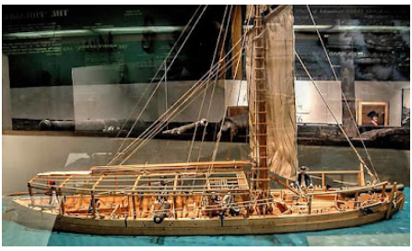
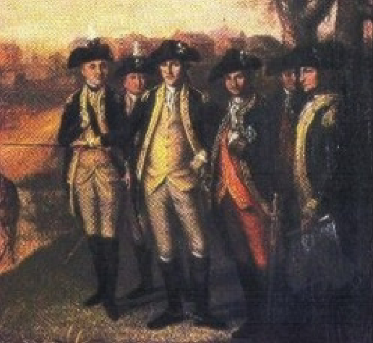
Building a Republican Military
How does the country keep its ideals while building a professional military?
After the war, there are two competing ideologies; the Federalists and Anti-Federalists
Federalists wan to build a strong military that protects American interests abroad
Anti-Federalists want a limited government that has little to no military
Since the Federalists wrote the constitution, they put some powers that the national government has over the military
Congress has power to prescribe a discipline for the militia
The president is the Commander-in-Chief, even of all state militias
Federal government has power to have a standing army
Even though the congress had these powers, since the anti-federalists were in power, they passed laws that made the powers weaker
The uniform militia act made the discipline for the militias, but there was no penalty for not following it
US military only had one regiment
Naval Expansion: Commercial expansion led to a bigger navy that leads to military action in other parts of the world
1790s – British and French fighting again; both say they will destroy ships trading with the other
French try enacting an agreement that the British are the enemy, but Washington refuses because he signed that document with the king of France, which they deposed
Forts are built across the coast for the militias to use in case of war
Under Adams, 6 frigates are built, and they are the best in their class at the time.

Slide 28
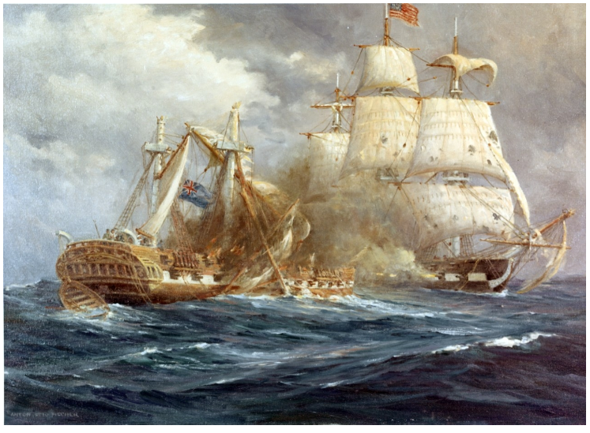
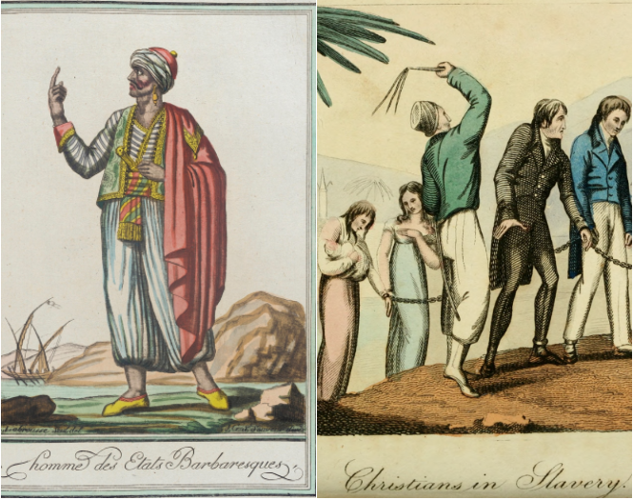
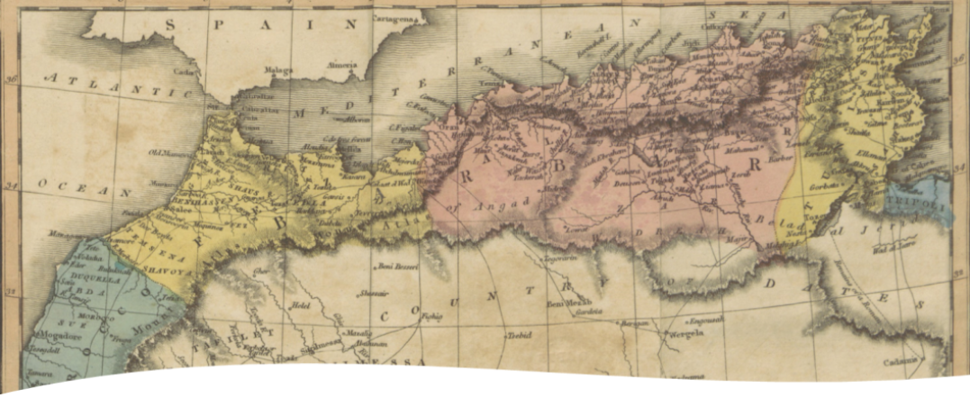
Jefferson (anti-federalist) comes into power and builds defensive gunboats to protect the coast. This is to try and convince the British and French that they don’t want to fight and only want free trade
This doesn’t work, so Jefferson passes the embargo act, saying that if we can’t trade with everyone, we’ll trade with no one.
Doesn’t work that well; results in the crippling of the Northern economy
Barbary wars
Against Morrocco, Algeris, Tunis and Tripoli
All theses states have pirate navies, which raid foreign ships and sell sailors as slaves
They ask for Bribes to not raid ships, which most European powers pay

Slide 29
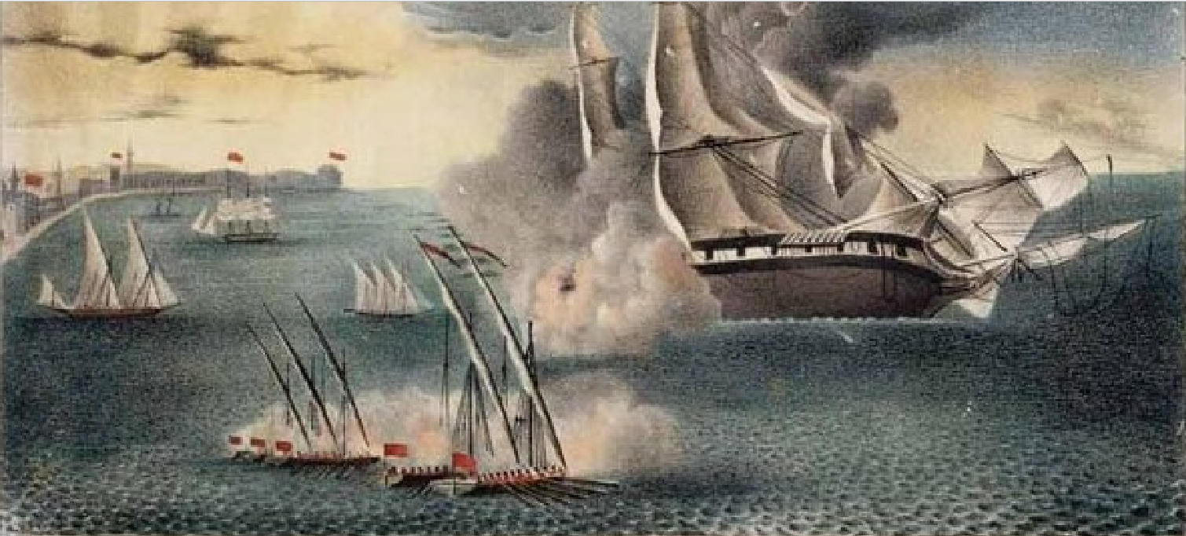
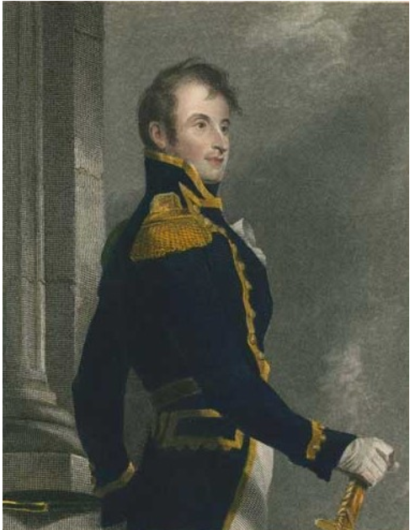
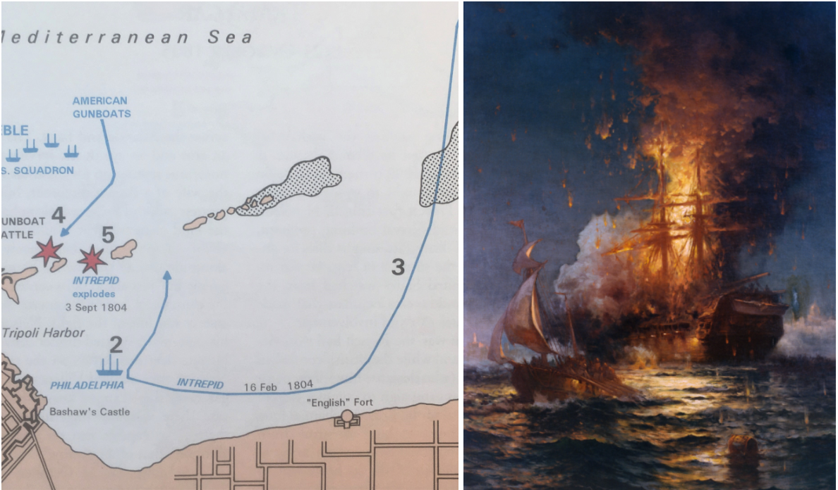
First Barbary War (1801-1805)
As a result of America not renewing its Tribute, Tripoli declares war on the USA
Jefferson sends a group of ships with one of the Frigates to take them down (led by Captain William Bainbridge)
Due to bad maps, the USS Philadelphia (frigate) runs aground. The 300+ sailors and ship are captured by Tripoli
Stephen Decatur’s Plan to Burn the Philadelphia
To avoid the ship being used by Tripoli, Decatur plans to destroy the ship
The ship he took was called the Ketch Intrepid
On this voyage, he had someone who could speak Arabic and communicate with the enemy
At night, he fakes as if his boat has an anchor issue and gets his Arabic speaker to convince the Tripolitanians to allow them to dock on the ship.
One the Tripolitanians realize the Americans have infiltrated their boat, it’s too late
Decatur and his men take the ship and burn it

Slide 30
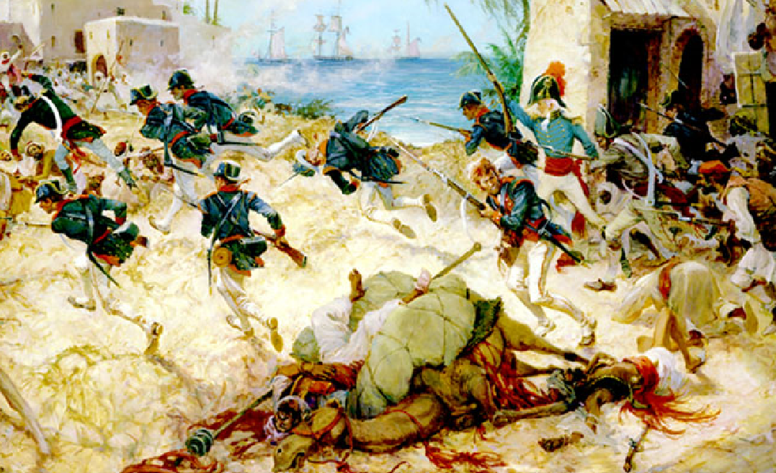
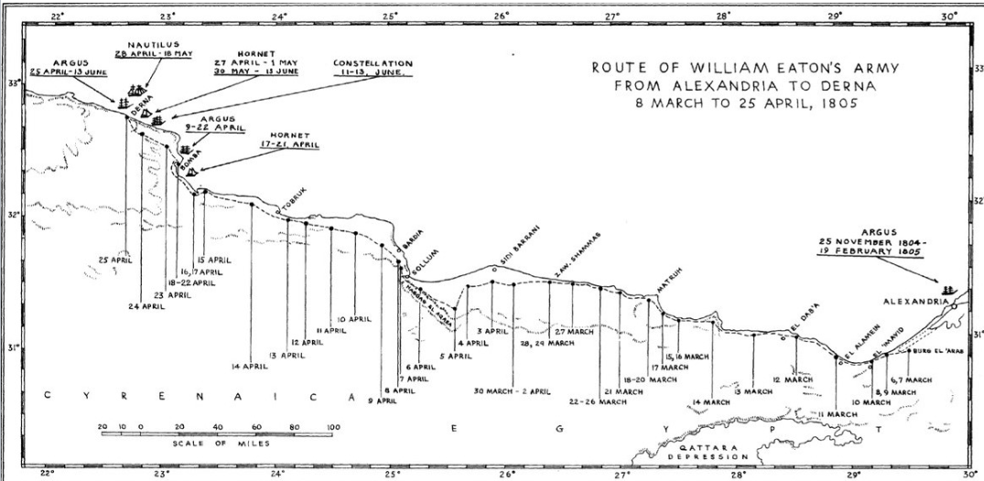
Plan to win the war – William Eaton (US console to Tunis)
Has a plan to replace the leader of Tunis with his brother (Hamet), who will then concede to American demands
Gets a group together of a few Marines and some Arabic mercenaries
Marines at this time boarded ships, defended ships and acted as the military police for the Navy
This group marches from Alexandria to Derna and takes the city.
The leader of Tripoli sends 3000 men to take back the city and the group must retreat, leaving the brother behind.
There is a treaty signed ending the war
Americans evacuate Derna, Americans don’t have to pay tribute anymore
Some main takeaways from this section:
The US will defend the freedom of the seas and its commercial ships
They will use whatever meager force they have to do so

Slide 31
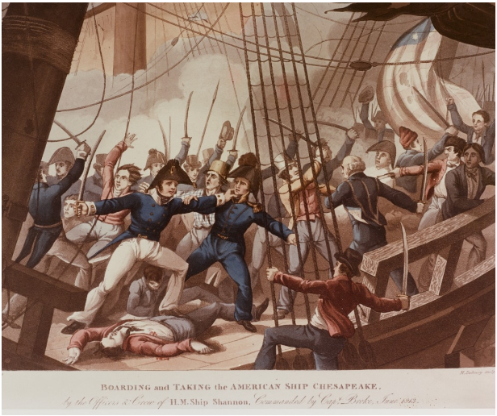
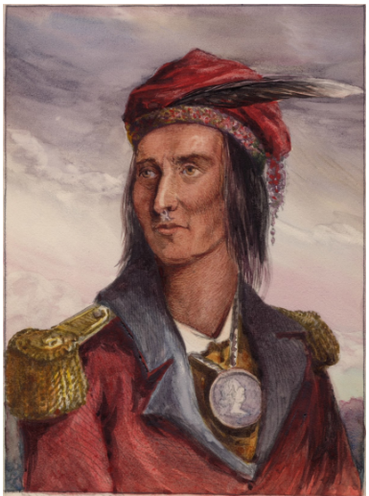
The War of 1812
What grievances did America have against Britain so that they would want to go to war with them?
British had interfered with American shipping going to France throughout the French Revolution
The British had impressed American soldiers if they thought they were born in the British Empire
At this time, the British believed that you couldn’t change citizenships after birth, so they used this to justify impressing soldiers
Roughly 42% of the navy was foreign-born, so the British had a lot of people they could justify impressing
The US wants to make the British change their stance on this
The British formed alliances with natives, supplying them with weapons and posed a threat to Westward expansion
At this point in time, a native leader named Tecumseh had created a pan-Indian confederacy aimed at stopping Westward expansion
US goes to war with the natives in 1811, and with the British in 1812
America saw this as an offensive war, which would be hard to achieve because of Britain’s large navy
So, their plan was to hit Britain where they were vulnerable (Canada) by using the blueprint
But this time, they would attack into upper Canada through Detroit

Slide 32

One of the major issues that the Americans had at the start of the war was the lack of officers
At this time, Westpoint had only produced a few graduates, and the revolution officers were too old
So, Madison asked the population for applications to be officers
Not many good officers would come from this
Eventually 850 officers were accepted
However, most of these officers would never learn how to drill men, write orders correctly, they would all use different drill manuals, and were generally incompetent.
First offense into Canada
Lead by William Hull, a revolutionary war hero, and very old
On their way to Detroit, their baggage was captured by the natives and Hull had a series of strokes
Once he arrives in Detroit he decides to march into Canada
However, shortly he hears of a force under Tecumseh coming, so he retreats to Detroit
The British eventually make their way to Detroit and he surrenders without fighting
Hull was court-martialed and sentenced to execution after the war (but Madison decides to spare him)
Many militia men who would go into Canada during this time would immediately leave once their enlistments expired

Slide 33

The navy would fare much better throughout the early war
Those frigates that Madison built would destroy British ships of equal class
However, they became useless once the British blocked them in port
More expeditions into Canada
At this point, the states were that mad no progress was being made, so some started to erect their own forces to invade Canada and defeat Tecumseh
Kentucky built a volunteer army under William Henry Harrison
Once he made his way to Detroit, he realized the British had locked down the river, not allowing him to cross
To fix this issue, Oliver Perry is sent to take care of the British
Since the Americans have no ships in Lake Erie, he must build his own ships
Defeats the British in the Battle of Lake Erie and allows Harrison to move into Canada
Harrison goes on to defeat the Indians and British at the Battle of the Thames and kills Tecumseh
This kills Indian resistance in the West

Slide 34



British offensives in 1814
After Napoleon was defeated (the first time), the British put a lot more resources into destroying the Americans (14,000 troops sent over)
They raided the Chesapeake Bay, destroying the capitol
They also sent forces to Canada and New Orleans
They also made their way into New York from Canada, putting ships in Lake Champlain
The USA sent Thomas Macdonough to defeat the British in lake Champlain
Like Perry, he must build his own fleet
He must produce a creative plan, because 90% of his men are in the army and don’t have experience on ships

Slide 35




Macdonough’s Plan
Since his men didn’t know how to work on ships, he would anchor them in place
He intentionally chose a place to do this where there was no wind, so the British would lose maneuverability
His men would shoot once at the British.
Once the British fired, he would cut the kedge anchors, winding his ship, allowing the other side to fire at the British
This was a victory for the Americans, making the British retreat into Canada
Winfield Scott and the regulars
Scott was able to get permission to train some soldiers in Buffalo using French manuals
At Chippewa and Lundy’s Lane, they were able to maneuver like European armies, shocking the British General

Slide 36



Andrew Jackson – American Warlord
Warlord – Someone who has troops with loyalty to him, who uses violence for personal agendas, and do not submit to the control of the state
Tennessee made their own army during the war and put Jackson in charge
His goal was to destroy the Red Stick Creeks in Alabama, who get support from Britain and Spain
While going to Alabama, he puts everyone on acorn rations, and declares he will kill anyone who refuses to eat them
Fights the battle of horseshoe bend, where Jackson routes the natives
After this battle, Jackson goes on a scorched earth campaign against the natives, taking 22 million acres of their land
Breaks native resistance in the Southeast
After seeing this, Madison sends Jackson to defend New Orleans from the British
Jackson declares martial law in New Orleans
The battle of New Orleans is fought, even though peace had already been negotiated (no one there had gotten the news)
British commander was stupid and ordered frontal assaults
Even after the battle, Jackson continues martial law
Imprisons a judge tells Jackson to stop
Kills a few men who try to leave because their enlistments expired

Slide 37


Treaty of Ghent
Status quo reestablished, which means the British can still impress soldiers if they want
Even though neither the British or Americans won, the Native Americans lost much of their land
Jackson’s Invasion of Florida
Madison sends Jackson to defend border with Spain because of native attacks (Seminole and Creeks)
Jackson invades Florida, with one of the reasons being that he wants to get some money from speculating the land
Kills a couple of British people in the process
All of this flips out the American government, who now must make some concessions with Spain
During these concessions, America buys Florida from Spain

Slide 38

The Armed Forces and National Expansion
Some trends during this period
Nationalism present, even without winning the war of 1812
Reforms that mark the beginning of military professionalism in the USA
Creation of a doctrine
Doctrine - ideas on how war should be fought and how to implement them
Use of national military to expand the nation
Reforms during the period
Long-range naval program developed
Creation of a general staff and commanding general
General staff reports to the secretary of war not the commanding general to prevent another Jackson situation
John C. Calhoun proposes a plan to make a force that has a lot of officers so in case of war, the national military can expand rapidly
This bill wasn’t passed, but a version of it was in 1903

Slide 39

Development of a professional officer corps
Only men trained at Westpoint were allow to become new officers in the US army
Led to 76% of the officers being trained at Westpoint in 1860
These officers have a cult of honor, pursuit of individual glory in battle
They had an identity that they were a specialty group that was different than the rest of society
They also are subordinate to the civilian authorities
They view the militia as bad and dislike them because they are untrained and unreliable
There are bills during this time that advocate for the abolishment of Westpoint due to their elitism
Westpoint war instructors Sylvanus Thayer and Dennis Hart Mahan were taught the only military strategy class in the school; the rest of the classes were engineering courses
The teachers got their course material from Antoine Henri de Jomini, a Swiss general under Napoleon
Always be on the offensive
Interior lines that allow rapid movement to defeat enemy
Bring about a decisive battle
Maneuver to capture key cities and transportation hubs
The ideas taught in this class were not well suited to the tasks officers had to go through in the 30’s and 40’s.
Guarding frontiers and fighting natives

Slide 40



Second Seminole War (1835-1842)
Longest continuous war with a group of natives
Started because of treaties with natives
The US government signed treaties with a few Seminole tribes to get them to move to Oklahoma
Not all the tribes were willing to move, so most disregarded the treaties
Some Seminole war leaders (Cataloochee and Osceola) decide to do first strike on Americans in Florida
They kill the Indian commissioner, and a column of troops led by Francis Dade marching from Tampa to a fort
Jackson, who is president, sends Winfield Scott to take care of the natives
Scott’s plan is to destroy villages in a cove of a river where many natives live
He sends three columns that communicate by cannon fire through the cove to destroy
The natives just leave, and Scott doesn’t achieve anything
Jackson fires Scott
Throughout the remainder of the war, Jackson goes through 7 other commanders
These commanders don’t want to adapt because they want to fight like European armies

Slide 41

Native’s plan: Fight a war of attrition with the Americans
Set up traps with village elders who lure the Americans into an ambush
This causes an insane number of casualties and money lost
A lot of men are lost due to disease gotten from being in the swamp so long
How do the Americans end up winning?
Violating truces, Partisans who fight like natives
Significance of this war
The US fails to remove all the natives from Florida
Shows the Americans that their doctrine is not fit for the tasks they have

Slide 42



The Mexican-American War
Civil military relations—how war is an extension of politics
James K. Polk and Sarah Polk
Polk wins 1844 election
He was a slaveholder, workaholic, and staunch supporter of Manifest Destiny
Sarah, his wive, would provide the morning news to him and help him influence other politicians
Wanted to take everything from Texas to California
How Polk got the war to start
Assembled navy in the Gulf of Mexico
Told the commander of the navy flotilla in the Pacific if the war broke out to take San Francisco
Sent Zachary Taylor and an army of 4,000 to Corpus Christi
Polk asked Mexico to buy the territory he wanted, and when they said no, he moved Taylor to the Rio Grande

Slide 43


Zachary Taylor
Modest Resume, hadn’t done much up until now
He was a Whig and opposed Polk’s policy
Denounced the annexation of Texas
Inevitably, there was a clash between American and Mexican patrols, and Polk saw this as his chance
Polk sends a message to congress asking if war exists between them and Mexico
He put it on a bill that was to give supplies to Zachary’s troops, and enough politicians were swayed to start the wars
This is a drawing (they made Westpoint students take a drawing class)
Polk had known this war was coming and had already developed a plan
Two armies would be sent to fight in Mexico
One would be Zachary’s army, where he would move South towards Monterrey
Another would be led by Kearny, and he would attack California
Polk assumed this would lead to Mexico surrendering

Slide 44


Taylor initially has great success
This is likely due to the region being depopulated by Comanche raids
Sept 1846 – Taylor arrives at Monterrey, which is garrisoned by a large Mexican army
Taylor splits his forces, sending one to flank from the West (William J Worth) and one would attack head on
This battle had the first urban combat that the country would fight in
Texas Revolution Veterans helped by blowing up walls of buildings to take the Mexicans inside out
Meanwhile, Worth’s men take out the Mexicans ion the hills
At this point, Taylor didn’t want to fight in the city anymore, so when the Mexican general proposed an armistice, he accepted.
The Mexicans got to retreat, and that army wouldn’t fight the Americans for eight weeks

Slide 45

Polk was irate about this armistice
He believed Taylor was trying to work against him
Does a commander on the ground have the power to call a truce?
Taylor taking the city made him a war hero
This led to people sending him letters asking him to run for president next term
Civil-Military relations
Something of note is that Winfield Scott, the other general during this war, was also a whig
Polk wanted to make sure that his generals didn’t take office after he left, so he tried to put his own guys in charge
Tried to make a Lieutenant General rank (Only Washington had this rank) to assign to one of his guys, but this didn’t work
Problem—Mexico wasn’t willing to surrender after the capture of Monterrey, so Polk had to create a new plan to get what he wanted
Scott planned to take Mexico city in a decisive battle and Polk agreed to it
He would land troops in Veracruz and march to Mexico city from there
He would also do his best to avoid Mexican armies and large fights and only take the cities
He ordered his troops to respect citizens and pay them for the supplies the citizens gave them
Veracruz (at the time the largest amphibious landing)
Very well planned; everything came in at the right time
Half of these troops came from Taylor’s force in Monterrey
Scott takes Veracruz; build his army up to 15,000 and starts his march

Slide 46


Unfortunately for Scott, some militia men’s enlistment expires, and they leave
No worries, Scott still heads to Mexico city and takes it
The Duke of Wellington says Scott must be the best soldier for pulling off this operation
Now, the occupation of Mexico City had to take place, which was not particularly good
Many women and guerillas were in the city fighting with the army, and Scott wanted the occupation to end as soon as possible

Slide 47


Polk sends Nicolas Trist to Mexico City to sign a treaty with the Mexicans
Supposed to get a substantial amount of land from Mexico
Trist’s background
He learned law from Jefferson, married his granddaughter and served as secretary to Jackson
Knew Spanish and lived in Spain for a while
Hardcore Democrat, arrogant, but a pacifist (Polk didn’t know this)
Polk ends up asking Trist to get all of Mexico if possible
Trist says no, Polk fires him, but he refuses to be fired
Trist negotiates the treaty of Guadalupe Hidalgo
America gets all land North of the Rio Grande, New Mexico and California
America pays 15 million dollars to Mexico
America also must prevent Comanche raids into Mexico and rescue citizens captured by Mexico
Polk is mad at this treaty, but recognizes that congress will be very mad if he won’t let them sign a treaty, so it is ratified
Polk exacts his revenge on Trist by preventing him from ever getting a job again, leaving him in poverty
Taylor succeeds Polk
During the war, a bill was passed that said the new land acquired during the war couldn’t become slave states

Slide 48



Civil War: Part 1
From Reconciliation to Emancipation
Years Leading up to the war
Anti-Slavery surge in the nation; do we let slavery expand into the new territory gained after the Mexican American war
Do Northerners have to enforce the fugitive slave act?
Republican Party created; main goal was to stop the expansion of slavery
Lincoln wins 1860 election despite not being on the ballot in most southern States
Secession: Immediately after Lincoln was elected, lower south Secedes (TX to SC)
Confederates Strike Fort Sumpter off SC coast to get weapons
Middle South Secedes after Lincoln asks for volunteers to stop the rebellion

Slide 49

Union Strategy – Developed by Winfield Scott
Use economic coercion with strong show of force while protecting property. Don’t forage or emancipate slaves
Naval blockade to prevent exports
Three large armies invade South (100,000 men each)
Just for comparison: Scott had 14,000 men during his invasion of Mexico city
First army: Down the Mississippi to cut off Texas, Louisiana and Arkansas
The purpose of this was to starve the confederates by preventing Texas beef from getting to soldiers
Second army: Invade Tennessee
Tennessee is a large railroad hub in the South and close to the border.
Third army: Invade the confederate capitol in Richmond
Confederate strategy
Jefferson Davis is president of the Confederacy
Initially focused on defense
Although, their armies entered Missouri and Kentucky, two slave states that hadn’t seceded yet

Slide 50




The Challenge of slavery for the Union strategy
Even though their plan was to respect the South’s slaves, the slaves were liberating themselves
Fort Monroe
Fort in SE Virginia that was still held by the union
The commanding general, Benjamin Butler, was appointed by Lincoln
Slaves were escaping to this fort from Richmond
They were being forced by the Confederates to build defenses in Richmond
Butler, a lawyer, says he can confiscate property of the enemy that was being used in the war effort. Justified by international law
This leads to more slaves coming to the fort after hearing this
Butler uses the slaves to help his fort and pays them
2nd Confiscation Act
Confiscates property of anyone who supports the rebellion
Declares any slaves that make their way to Union lines as free

Slide 51


Emancipation as a necessity
Slaves help the confederates, so freeing them would help the union
The problem with this is that Lincoln knows that the constitution protects slavery, so he needs to find some way to get around it
Uses his war powers as a president to declare martial law in combat areas
Emancipation proclamation
If states don’t return to the union before Jun 1st, 1863, any slaves living in those states will be declared free
Doesn’t apply to the territory already in the union at that time
Leads to a lot of freed men joining the army
At one point, 10% of the army is made up of black men
At this point in the war, but within the first year of war, it becomes clear there won’t be one. Why not?
Untrained Troops
The army before the war only had a few ten thousands of troops. The ballooning and instant start of the war led to battles being fought by untrained troops

Slide 52



Uniform problems
Both sides had troops with blue and gray uniforms and red, white, and blue flags
This leads to troops fighting themselves in the confusion of smokey gunpowder
Inexperienced officers
The way troops were recruited were by local bankers. They would create the companies, and they would make themselves and their friends' officers
Westpoint graduates were also not prepared for their tasks
All of them were instantly promoted to field generals upon the start of the war.
Many of them had yet to get used to their new roles

Slide 53


Rifled Muskets – Springfield model 1861
These rifles had a range of 600 yards, which outranged the previous guns that had only 100 yards
Possible due to grooves in the barrel that spun the mini balls
The only issue is that they needed to be sighted properly, which didn’t usually happen
Their pronounced arcs led to troops firing over the heads of their enemies
Officers still only ordered their troops to fire within 100 yards at the beginning of the war
Tennessee campaign – Ulysses S Grant
Grant left the army after becoming an alcoholic after the Mexican American War
At the start of the war, instantly promoted to Brigadier General
Initial Situation
Confederates had positioned themselves between Columbus and Bowling Green in Kentucky

Slide 54



Grant has a plan to take two weakly defended ports upstream so he can move his gunboats up there (Donaldson and Henry)
Grant captures a whole Confederate army and has great positioning to move further South, but the Confederates are still willing to fight. Grant needed to complete a conquest of the South
Grant sees this as his moment to take the confederate railroad hub
However, the confederates counterattack Grant when he didn’t expect it
Battle of Shiloh (April 6, 1862)
Initial confederate success. They route the unexpecting union soldiers
Grant must retreat to the gunboats, but one Union division gets surrounded by confederates.
This division holds out long enough to give the union time to recover
Grant counterattacks the next day spectacularly and wins the battle
This battle had more casualties than all previous American wars combined
After the south don’t surrender due to this battle, he realizes he will have to do a complete conquest
Transformation from reconciliation to hard war

Slide 55



Civil War: Part 2
Campaigns
As the war progressed, adjustments needed to be made by both sides
Integrating conscripts was crucial
Generals needed to be able to manage campaigns that spanned hundreds of mile.
Tactics needed to be developed to overcome trench warfare.
April 1862, Confederacy starts conscription
Initially all white men 18-35, but by the end it was 17-45
Tried to use being conscripted as cowardice to get people to join
By the end of the war, nearly full enlistment of all eligible men
There was a strong resistance to being drafted in areas that didn’t vote for secession
In areas like Tennessee and Alabama, draft dodgers would hide in mountains when conscription officers made the rounds
On top of that, a lot of men would desert after joining the army
There was direct impressment by generals in the confederate army, which included Braxton Brag
He appointed Gideon Pillow as his conscription bureau
Gideon would end up gathering 25,000 men to be forcefully conscripted
He would even conscript men who had exemption cards given to them by the civilian government if he deemed the reason not good enough

Slide 56


Union conscription (Enrollment act of 1863)
Men and aliens who filed for naturalization aged 20-45 were considered eligible
States were given a quota with 50 days to fill it with volunteers. The unfilled spots were filled with conscripts
Bounties were given to volunteers, but the money was so bad that only impoverished people would take them
A $300 Commutation fees could be paid, but that was removed in 1864
Conscript quality
Men who volunteered in 1861 and 1862 hated the conscripts. They saw them as marginal and only caused trouble
These troops would write back to home saying how the conscripts were “hardly men”
The Roughs – Irish immigrants conscripted into Union armies
They were from the Northeast and would cause lots of violence. They would get drunk and start brawls
Shower baths were given to them (cold showers)
Up until this point, the American population had prided themselves on their volunteer only army. They saw the citizen-soldier as the best man for the job. However, with the conscripts, generals started having to use their resources to keep men in line
File closers had to be used to shoot people trying to leave a march and escape the army

Slide 57



Change in Confederate strategy
In 1862 Robert E. Lee was put in charge of the army of Northern Virginia
He immediately starts dealing major defeats to Union armies in the area
Lee’s Strategy becomes to try and get the Union population to stop supporting the war by dealing a blow to them on their own territory right before the election to vote someone in who will make peace
The democrats at this time were against conscription in the North, which was generally unpopular
The Union suspended the Writ of Habeus Corpus to arrest draft dodgers on the spot
Also hoped that a victory on Union soil would lead to European support
Lee’s invasions of the North
Late 1862: Antietam, Maryland. Result: draw
1863: Gettysburg, Pennsylvania. Result: Confederate loss
While all that was happening, Grant was taking care of business in the West
Using the strategy of exhaustion, which means attacking resources used by the army and the will of the defender. This was done while at the same time not being indiscriminate
Vicksburg Campaign:
Motivation behind capturing Vicksburg aligned with the exhaustion strategy
By taking the Mississippi River, the Union could cut off the Southeast from Texas beef, Louisiana rice and Arkansas lead
Grant had been trying different ways to take the railroad city of Vicksburg many times before, but this is the one that worked. Let’s see why.

Slide 58



Vicksburg Campaign (March 31-July 4, 1863)
Not much happens until Grant gets onto the Mississippi side of the river
The general in charge of defending Vicksburg thought Grant would march straight to Vicksburg upon crossing the river, but Grant had a plan.
Before attacking straight into the fort, he needed to take any chance the Confederates had of reinforcements out of the equation.
Grant and his men marched to Jackson, and on the way cut rail and telegraph lines between Jackson and Vicksburg to prevent a coordinated strike against his army
Once Grant gets to Jackson, he takes the city and moves towards Vicksburg
The General in charge of defending Vicksburg sends a large force East to stop Grant, but through a series of battles, Grant defeats them
One thing of note is that the force that retreated from Jackson was not able to assist the confederates during these battles, because they had no communication with them
Grant then takes Vicksburg after a long siege.
Over 17 days, from when Grant landed on the East side of the Mississippi to the start of the siege on Vicksburg, Grant defeated four enemy forces, that had been combined, would have been as large as his own
Show how important disrupting communications and taking out possible reinforcement armies was in capturing the Mississippi

Slide 59


Overcoming Trench warfare
Grant was promoted to commander of all Union armies operating in the Confederacy (which was most of them)
He believed in creating a large series of campaigns across the entire front line with the confederates, so they couldn’t move troops to defend easily
Five fronts were planned. One attacking Mobile Alabama, One in Atlanta, and three in Virginia
Consistent pressure put on the confederates wouldn’t allow them to reorganize themselves
Grant’s army groups
George Meade and the army of the Potomac was sent to defeat Lee’s army of Northern Virginia and move on Richmond
William Sherman ans the armies of the Cumberland, Tennessee and Ohio move against Joseph Johnston’s army and move into the Georgia interior to damage war resources

Slide 60






How do the Confederates plan to defend against this?
Meet every Union advance with an entrenched defense
The defenders can make trenches faster than the attackers are able to take them
The confederates set up miles upon miles of trenches in Virginia to stop Grant
How is the Union able to deal with these trenches?
Sherman’s tactic was to use skirmishers to harass the defenders while the artillery was getting set up. Once that is complete, barrage them with artillery and flank with infantry
Skirmishers are troops that operate independently of an officer, meaning they can move, shoot, move, and take cover as they please

Slide 61


Civil War: Part 3
Guerrillas and Cavalry
Guerrillas – not affiliated with Union or Confederate forces
No uniforms were used, meaning they were able to hide among civilians
Attacks were centered on Union garrisons
Women would act as the supply line for the guerrillas, providing them with materials concealing uniforms. They would also be able to report Union army whereabouts to their husbands, who would then attack the union at night
There was a strong federal response to these guerrillas because they are not deemed to be legitimate combatants. This is because to be a legitimate combatant you need to wear a uniform and be a part of a military hierarchy of a nation state.
John Pope says he will burn down every house within 5 miles of a guerrilla attack because he knew the civilians were in on it
Confederate response to guerrillas
Partisan Ranger Act – requires guerrillas to register with army
Although no one does this, and the Confederate government does nothing to enforce it
John Singleton Mosby leaves the confederate army to join the guerrillas in Northern Virginia.
He raids and spoils union trains and such to get materials for the army
Lee wanted to get rid of Mosby until he figured out how much Mosby helps him. Lee then made an exception for Mosby to not have to follow the law.
A note on Mosby: He was a very interesting individual
In high school, he shoot a bully. He does this guerilla stuff during the civil war. Joins the republican party after the war and is the only one to do so. Becomes friends with Grant and becomes an ambassador to China. Reports the entire American embassy in China for corruption. Spends his later years writing about how college football is ruining young people.

Slide 62


How Grant Deals with the guerillas
Arrests all the men of Middleburg Virginia and confines women to homes
Imprison partisan families, burns homes, mills, and crops
Executes 12 of Mosby’s men
Incarcerates all men of the Loudon Co. under the age of 50
General Order 11, August 1863
Removed the civilian population from four Missouri Counties on the Western border of the state
Troopers set homes and fields ablaze
Cavalry innovations
At the start of the war, the USA only had 2 dragoon regiments, and they had been neglected.
In the 19th century, cavalry was supposed to be used for Reconnaissance, Screening, covering and threatening flanks, shock charges, and long-distance raids. (non of which the American cavalry did)
Union cavalry was extremely pitiful at the beginning of the war

Slide 63



However, in 1863, there was a shift towards competency
The cavalry adopted breech loading carbines, which allowed the troops to fire 20 rounds a minute
James Harrison Wilson was allowed to create his own cavalry-only army
The goal was to move fast and conduct massive raids
Not under infantry command, so they could act on their own
3 divisions of 12,000 mounted troops
Wilson’s tactics
Dismount and use their superior rate of fire to force the enemy to break
Once there is a break, charge through it with the cavalry and kill everyone with sabers

Slide 64


Wilson’s Raid – Goal is to destroy remaining confederate industry and neutralize remaining armies
Using the breach tactic, Wilson forced confederates to retreat to Selma at the battle of Plantersville
Battle of Selma
Selma has three extensive fortifications: A line of sharpened tree spikes, barbed wire and a palisade with canons
Wilson only has 1,600 men compared to the confederate’s 7,500
Upon arrival, Wilson uses the high fire rate of the guns to barrage the confederates, while his men clear the spikes and barbed wire for the horses
Once the obstacles have been cleared, the mounted infantry move in and sweep out the confederates
During the civil war, to win an offensive battle, usually you would need 3 times the men as the defenders. The high fire rate of the breech loading rifles are even able to work against fortified defenders, which is significant.
After the battle at Selma, the Cavalry goes on to capture Jefferson Davis in Georgia

Slide 65
Sherman Correspondence
How does Sherman justify his removal of the citizens of Atlanta? How does he answer the objections of Gen. John Bell Hood and the mayor of Atlanta?
Sherman’s main argument for the removal of the people towards the confederates is that he is bringing war with him to Atlanta, so it is best for the people of the city that they leave.
Hood and Atlanta's mayor’s objections mostly come from the fact that removing people from their housing is cruel. Sherman’s response to that is that it was the confederacy that initially brought war to the nation by taking armaments from the union and moving troops into Kentucky. During the time of the war, confederates had no problem causing chaos in the North, so how can that compare to Sherman giving them the option to leave and not be dragged into conflict.
What reasons does Sherman give to persuade Grant that marching through Georgia is the best operational objective?
At this point in time, the Sherman has a problem. Confederate generals Hood and Beauregard are around the Alabama/Tennessee area creating havoc and can pose a threat to Union defenses in Tennessee. Jefferson Davis is mad about the development in Atlanta and has made it clear that his generals need to find a way to get rid of Sherman in Atlanta. Hood already tried to cut off communication lines to Atlanta, but that didn’t work because Sherman took care of it. The other way the confederates could go about this is by luring Sherman out of Atlanta by attacking assets in Tennessee, which would compel Sherman to move to cut off the confederate retreat. Sherman proposes by being on the offense—attacking Georgia—he will force the confederates to react to him, which will put pressure off Tennessee
Based on this correspondence with Grant, write a 1-2 sentence summary of Sherman’s strategy for defeating the Confederacy.
By attacking into Georgia, the world and confederacy will show that there is nothing stopping the union from winning the war, as they have such a superior force.
What elements of Special Field Order No. 20 are designed to protect citizens and restrain soldiers?
Soldiers were not allowed to enter homes or trespass on property
Commanders are allowed to destroy houses, but only if there is resistance from guerillas or inhabitants. Proportional destruction to the damage dealt to the column will be dealt
Horses and work animals can be taken, but compensation will be given

Slide 66
What does Sherman’s retaliation correspondence indicate about the behavior of Union soldiers during the march through South Carolina? What does the correspondence indicate about Sherman’s views about that behavior?
From the confederate’s account, the union soldiers have overstepped their initial orders by burning down towns along the march. Sherman recognizes this is the case but argues that killing of his men is not justified. He believes that the killing of his men justifies a killing of a confederate prisoner.
General Orders No. 100 was the code that governed Union armies in the field. Did Sherman’s treatment of the citizens of Atlanta, Special Field Orders No. 20, and his execution of Confederate prisoner of war conform to the provisions of the code? Be specific to the articles in G.O. 100 that justify your answer.
Sherman’s execution of prisoners is not justified under art. 16, which states that there should be no suffering for the sake of revenge.
Sherman’s march through Georgia is justified under Art. 17, which says it is lawful to starve the hostile belligerent so that it leads to a speedier surrender
The burning of houses by union soldiers during the march is not supported by Art. 22. Which states that private property of individuals should be spared if possible
Special field orders No 20. follows article 25, which states that disturbance of the inoffensive individual is the exception in modern European wars. Shermans orders order as little disturbance as possible
Article 27 justifies retaliation of killing the confederate soldiers, as it states retaliation is the sternest feature of war.
Article 38 generally justifies the killing of prisoners, as the retaliation given by Sherman is a way to convince the confederates of stopping killing their foragers. The retaliation of Sherman was not excessive.
Field order No 20 is justified by article 29, which says sharp wars are preferable, and that the restoration of peace is a priority. The purpose of the march was to end the war.
Field order No. 20 is not supported by article 38 which says receipts must be given if private property is seized.
Article 19 justifies Shermans ask to remove the civilians from Atlanta, as the commander is supposed to inform the enemy of their intention

Slide 67


Slide 68


Slide 69



Reconstruction
Rapid Demobilization after the war
At this point, the American government and people still don’t believe in a standing army after at times of peace
Within a year, the size of the military went from over a million to 25,000
In 1870, only 52 ships were in the navy and most of them were obsolete
Integration of Black Troops
The US Colored Troops were created
Originally, they faced discrimination, as they were separate from the white troops and only white commissioned officers oversaw them
At the start of the employment of black people, they were mostly used for fatigue work.

Slide 70


During the civil war, blacks completed their first successful civil rights protest
Initially, blacks were supposed to be given the same pay as white troops, but the government skimped out and paid them less
The 54th and 55th Massachusetts led a protest that expanded to most black troops.
They would refuse pay if they were to be given less
This worked because Northerners saw this as honorable
They would still be willing to fight and due their duties even if they weren’t getting anything back from it
Eventually, congress passed a law giving blacks equal pay and back dated it to the emancipation proclamation.
Also, during the war was the first time that blacks got to represent themselves equally in a court of law (military justice)
Southern civil war (1865-1877)
The civil war ended as a series of surrenders—there was no treaty.
Final surrender in 1865
After surrendering, confederates had to go back home where black men were usually put in charge of the garrisons. This was done on purpose by the Union
This leads to a build up of resentment towards blacks
After the war, a terror campaign against blacks and whites that supported the union started
Reconstruction Act
Separated the South into 6 military districts, each government by a general
Forced Southern states to amend their constitution allowing black men to vote before being allowed back in the union
After Lincoln died, Johnson became president, who people usually say is the worst in history
He wanted Southern states to be readmitted quickly and not require states to allow blacks to vote

Slide 71



Disputes came up between republican military governors and Andrew Johnson
In the reconstruction act, people who held office in the South and supported the rebel government weren’t allowed to vote
Phil Sheridan interpreted this very strictly, and Johnson didn’t like it, so he fired him
This and other decisions made by Johnson lead to the republican congress impeaching him, so he complied to their demands more after that
Led to a stricter interpretation of the reconstruction act being used, and biracial governments being put in power

Slide 72

After the end of the occupation of the South, increased violence towards blacks and republicans occurred
Hundreds of political murders happened during the 1868 elections, leaving hundreds dead.
Lead to extremely low turnouts among blacks and republicans
Monroe County Mississippi
The KKK and other para-military groups set up in front of the courthouse on election day
They said that if they saw anyone vote republican there that they would open fire on them
They knew who they voted for because they would either bring a blue or red card up to the ballot and put it in
No votes for a republican were counted in the county
Battle of Liberty Place – New Orleans, 1874
3000 paramilitary soldiers attempted to steal arms from the city
New Orleans militia came out to fight them
After a bloody battle in the street, the paramilitary captured the weapons and distributed them among people in Louisiana
All biracial governments established during the occupation fell

Slide 73

Western Wars
There were four zones of warfare against native Americans
Midwest with the Comanche ans Sioux
Southwest with the Apache
Mountains with Cheyenne and Sioux
Pacific Northwest
Comanche – Panhandles of Texas and Oklahoma
The government wanted to move them into an Indian reservation in Oklahoma
The initial strategy to defeat them was to prevent them from hunting buffalo
Last Successful Comanche War
Ranald Mackenzie vs. Quanah Parker
Ranald get gets the Tonkowah – the Comanche’s enemy to lead them to Palo Duro Canyon, where the Comanche have set up camp for the winter
Mackenzie sends forces on both ends of the ravine and moves inwards to the Comanche
Lets the Comanche escape, but not before killing all their horses

Slide 74






Mackenzie killing all the horses is the nail in the coffin for the Comanche
One by one, the Comanche come to the reserve because they can’t hunt any buffalo

Slide 75

Wars against the Apache (1860-1886)
20-year struggle between the Americans and Apache
What made the Apache last so long?
Terrain – the Apache were much more suited to the rough terrain and heat than the Americans
Use the borderlands to escape armies
Could move into Mexico to evade American troops and vise versa for the Mexicans
Mobility – The Apache saw their horses as tools. They would make their sprint until they collapsed from exhaustion, then kill them and use them for meat to keep moving
American were much nicer to their horses and had emotional attachments to them
Apache’s basic maxim of warfare – Maximum damage while sustaining minimal losses
Their main tactic were ambush strikes
Sometimes they would use a decoy like a women with a baby to lure Americans somewhere to strike
Infiltration
At night they would surround a camp of Americans and attempt to make their numbers look bolstered
If the Americans looked scared, they would attack

Slide 76


George Crook and his counter insurgency techniques
His main strategy was to follow the Apache into the rough terrain where they had their camps
Instead of using horses for this, he would use mules, who were better suited for this task
He was so committed to this that he made special saddles for the mules and ate with his mule drivers instead of his officers
Another thing that helped him massively was getting indigenous allies
The natives could trust him because he would promise them anything that he couldn’t deliver, unlike other generals
He would also recruit Apache scouts who defected, who would then take them to the strongholds of the tribe

Slide 77


He put ambush parties at watering holes between their camps and the border to catch them moving between the two
Overwhelming success against the natives, sends them to the reservation
Sadly, the US government makes him send the scouts there too
After the defeat of the Sioux and Cheyenne, no more major native wars
From the beginning of this course to now, most conflicts were against natives
Would’ve served the Americans better if they documented and taught the tactics leaned through these wars both during this era and during the 20th century when they were fighting Vietnam.

Slide 78




Birth of an Overseas Empire
Expansion of the Navy
After all the native American wars were close to wrapping up, there was a transition to expanding overseas forces
A large amount of people were advocating for the US to become an overseas empire with colonies and natural resources to become a global economy
To start, there was a need for naval stations and overseas bases for the navy
Alfred Thayer Mahan
Naval officer and did lectures at the US naval war college
Published a book about naval power during the 1600-1700s to make conclusions about naval power today
The book became extremely famous, and many influential people read it
The main thesis of the book was that naval power is the basis for commercial success and becoming a world power
Whoever has the best fleet will be able to rule the world by defeating another’s navy in a decisive battle
Offense is the best defense
Passive defense is having an army and good coastal defense
Active defense is being able to destroy enemy nation’s fleets at seas.

Slide 79

Benjamin F. Tracy
Secretary of the navy during the 1890s
Read Mahan’s book and his takeaway was that the USA should build a large fleet
Wanted to build modern battleships—8 for the Pacific and 12 for the Atlantic. They were all going to be designed to be the top of their class
Initially, congress authorized 3 battleships, all with limited range. This was due to the anti-imperialists
Later, 6 new battleships were made with an unlimited range
The battleships would operate in squads together, which hadn’t happened with large ships in the US navy before
The ships ran on coal for fuel and required frequent stops for refuel, which increased the need for colonies
During this time, the army was still doing nothing
It was so small; Germany didn’t even count it as an army
It will also be an embarrassment during the Spanish-American war
Spanish-American war context
Rebels have been fighting the Spanish government since the 1860s
Spain has been trying a thorough campaign to stop the rebels
Round up the rural population and put them in concentration camps, then go into the countryside and burn everything to the ground
This was a common strategy for fighting guerrillas at the time
The Union did it in Arkansas
These actions have made their way to the American people, who sympathized with the rebels

Slide 80


USA Getting involved
The rebels in Cuba transfer a letter from Spain saying that they will never give up Cuba
Spain sent a letter to the US insulting Mckinley’s manhood and saying Spain will not change its stance on Cuba
Feb 1898: USS Maine sinks in Havana harbor
The ship was there to make the US presence known
At the time, the US government used this as justification for war, as they thought Spain sunk the ship
Later, a diving expedition, it was revealed that the cause of the sinking was due to an explosion in the fuel compartment
McKinley sends an ultimatum to Spain demanding Cuban Independence
Congress passes an act allowing for force against Span for Cuban independence
This was passed with the Teller amendment, saying that the goal of the war was not for imperial expansion
Mckinley’s Strategy
Limited war—the goal for the war was not very large, so a large war was not necessary
No invasion of Spain needed
By attacking the periphery of the Spanish Empire, lots of small victories would cause the Spanish to capitulate
This meant most of the conflict would be a naval war, which suited what the United States had been preparing for

Slide 81




Teddy Roosevelt’s Plan
First, Roosevelt tells the naval squad near to Manila to be ready to strike at a moment’s notice
Conduct a blockade of Cuba
Intercept ships going from Spain to Cuba
Army will also mobilize in case they are needed
Calls up 125,000 national guardsmen
During this time, the national guard had no federal oversight
They hadn’t gone through basic training nor had any simple equipment
Government suddenly had to supply an extra 125,000 men with equipment when it only had around 25,000 to supply before
Philippines
George Dewey in charge of the squad in Asia
He is a highly decorated veteran from the civil war
When Dewey gets the word from Roosevelt, he prepares extensively
Paints all his ships gray and throws all wooden and glass items overboard to prevent injury
Takes Guam
Sails to Manila Bay in 1898
The Spanish fleet in the Philippines is outdated
The admiral knows that this and moves away from Manila to prevent civilians from being injured
But also, he moves away from the coastal defense that can protect him
Within a few hours of contact, the Spanish fleet is obliterated

Slide 82


Cuba
The plan for the navy was to have two naval squadrons meet at Santiago harbor
This ended up blocking the Spanish fleet in the bay, who now was not motivated to leave
The American fleet couldn’t just go into the harbor because of the coastal defenses, so they call in the army

Slide 83



Army in the war
The plan to take Santiago bay is to have the army take out the coastal defenses and then the navy can go in and take care of the fleet
The 5th army corps is sent to Florida, where they will be put on transport ships and be sent to Cuba
There is only one railroad to the port they are leaving from, causing a massive rail jam
Once they do get on the transports, Americans hear of a Spanish fleet heading towards Cuba, so they keep their men on the transports to be safe and not have them get sunken
These transport ships are only supposed to be used for a few days and are overcrowded
William R. Shafter
In command of the troops in Cuba
Once he gets there, plans to take the hills El Caney and San Juan outside the city.
Takes the hills in a few hours; some issues caused by not using smokeless gunpowder
The John Parker Gatling gun is a major asset, can fire 6,000 rounds in 8 minutes
Shafter stops after taking the hill and refuses to take the fortifications blocking the navy from moving in
Luckily, the Spanish admiral attempts a breakout of the bay, leading towards the surrender of the city

Slide 84



Result from the war for the army
5,462 casualties, only 379 of which were lost in battle
This is bad, as a lot of the casualties came from the poor conditions on the boats, Florida, and the lack of equipment of the national guardsmen
Dick Act (1902)
A permanent general staff was created to prepare for war
Required the army to consult engineers for mobilization plans
Required an improved force of volunteers to be used beyond the national borders
Gave money to the national guard, but now the national guard gave control over training and organization to the army

Slide 85


Preserving the Empire
Conflicts protecting colonies and conflicts with neighbors
US-Philippine war (1898-1902)
War of occupation leads to a war of conquest
Leader of the Philippine resistance was Emilio Aguinaldo
The Philippines declared independence when the war started
Besieges Manila
Major general Wesley Merritt put in charge of American forces
He was a cavalry officer during the civil war and fought in Apache wars
Initially, he was ordered to not get entangled with the Filipino independence movement
McKinley didn’t know if he wanted to take the islands as a colony yet
The Spanish general put in charge offered a pretend battle to the Americans, so he didn’t lose the Spanish honor.
Spanish retreat after putting up a fight, and at this point, McKinley decided to take the Philippines
Real battle of Manila (1989)
1000 Americans lead an offensive against 20,000 poorly trained Filipino troops
Largest battle for the USA between the civil war and WW1
Offensive peters out after a little bit

Slide 86



Filipino change in tactics to a guerrilla war
Forces were spread out between multiple armies
This meant that the defeat of one army wouldn’t have much of an effect on all of them, but no offensives could be planned
Ambush tactics were used: pits with spikes were covered with bamboo leaves for unsuspecting soldiers
Underground governments were instated in cities of American control to harass people who supported the Americans
Planned an offensive during the election season to attempt to get an anti-imperialist in office
Didn’t work, Teddy still won
US Response
Taft Commission: Transition to civil government from occupation
Build roads, bridges, schools and give medical support to the population
Send in Arthur MacArthur
Arthur was a volunteer in the civil war (Wisconsin) and won the medal of honor at the battle of Chattanooga when he led a charge while carrying the American flag
Douglas MacArthur’s Dad
Has 70,000 troops (70%) of the army
He captures Aguinaldo when he intercepts a messenger and sends a disguised force to force him to surrender
Has garrisons work with the people instead of patrolling them
Pacifies Sumar (most resistant island) by slaughtering all livestock, burning fields, and killing all men
Uses concentration camps to round up 300,000 people where he then sent 4,000 troops to kill all remaining people and destroy foodstuffs
In 1902, the last guerrilla commander surrenders

Slide 87



Interventions in Latin America
Goals throughout the campaigns: Stabilize region, prevent reestablishment of colonies
Mexico 1914
In 1913, Victoriano Huerta led a coup against the government, and civil war almost immediately erupted.
Germans were trying to send military aid through Veracruz, and America didn’t like that, so The Americans invaded the port with a force lead by Frank Fletcher
The initial troops that got there were bogged down in street fighting, but marines came in and used similar tactics to the ones used by Zachary Taylor in Monterrey

Slide 88



Mexico 1916
Pancho Villa wants support from the USA, but the Americans don’t give it to him.
So, he conducts raids into the US, killing 15
Wilson orders Punitive action against him, and sends in 10,000 troops led by Pershing
Mexico mobilizes to stop the US, and Wilson mobilizes the national guard
This is the first time the national guard was used without congress first declaring war
Both governments end up backing off once Wilson realizes he will have to go to war with Germany
Haiti 1915-1934
Since Haiti had gotten independence, there had been 102 civil wars and 22 of the past presidents hadn’t served their terms
Marines occupy the port towns and within 2 months, the country had been pacified

Slide 89




Modernizing the Navy
At the beginning of the century, the Great White Fleet was built with the best battleships in the world
However, they became instantly obsolete with the creation of the HMS Dreadnaught
10 12-inch guns on 5 turrets with a range of 25,000 yards
Started the naval arms race
The USS Pennsylvania was created as a response to the dreadnaught
Displaced 32,000 tons, 24 mph, 12 14-inch guns with 4 turrets, used oil
1916 Naval Act
Had the goal of being “second to none”
Built to serve across 2 oceans
5-year program to construct 156 modern vessels
40% increase in the size of the navy
The act made more naval bases in on the coast of the contiguous US rather than overseas where they were more needed
Due to congressmen wanting bases in their states

Slide 90




After the release of the dreadnaught, everyone was following Mahan’s doctrine of building a large fleet for a decisive battle, but asymmetric threats became more important
No one wanted to lose the dreadnaughts after all the money was put into them
Asymmetric threats:
Torpedo boats – carried compressed air torpedoes to fire at large ships
Torpedo boat destroyers – used on periphery of fleet to block torpedo boats
Submarines – didn’t have a set place in the navy, but many ideas
Scouting, commerce raiding, and attacking big boats were all ideas
Modernizing the army
Secretary of war Elihu Root had two ideas
Have best trained officer corps
Always fight with volunteers
Creation of a lot of schools to train officers
Learn strategy, operations, war games
Change in underlying belief of the civilian soldier to the institution to pass on techniques

Slide 91



The Great War
Initially, The US was neutral
Americans didn’t know who to support
There were tons of German immigrants and tons of Irish immigrants who hated the British
German Unrestricted Submarine warfare
Unrestricted submarine warfare was a tactic used by submarines to destroy all merchant ships without giving them any warning
Germany destroyed all ships in the shaded area in the picture below
This tactic gradually brought America into the war, as the sinking of all ships went against America’s freedom of the seas.
When the Lusitania sank, America demanded all unrestricted submarine warfare stop.
Germany initially complied, but then concluded that Unrestricted submarine warfare was worth the risk.
They thought the US wouldn’t be able to field a large army until 1919
America declared war

Slide 92

America’s goals of the war were outlined in Wilson’s 14 points
1-5 were focused on dismantling empires, 5-13 were focused on self determination, and 14 called for the creation of the league of nations
Article 2 and 5 were the most controversial among Europeans
2 called for freedom of the seas
5 called for colonies to be freed
To accomplish these war goals, a large ground force was needed to promote America’s diplomatic authority
They had a late start by 3 years, so getting their goals accomplished would be an uphill battle
For reference, the Germans had lost 1.2 million men by this point.
The largest army America fielded before this was 1 million in the civil war. The army at this point had 300,000 men

Slide 93


Naval combat
Mahan’s decisive battle theory every nation had played into did not hold true
The only large dreadnaught battle was the battle of Jutland, and it was completely indecisive, as the Germans just retreated to port and stayed there for the rest of the war
Admiral William Simms was sent to be in Britain before America entered the war
He was very persistent
Learned of the magnitude of British loses and knew the Germans were suffocating the British
The British told him they would have to surrender by late 1917 if the rate at which ships were being sunk continued
Kept insisting that the Americans send destroyers to Britain
Helped develop the convoy system, where merchant ships would be better guarded from submarines
Went up to the prime minister himself to make the case for the system
Observation balloons were used to detect incoming torpedoes, and destroyers were dispersed across all sides to hunt down submarines
This significantly decreased the loses of merchant ships the British sustained from 20% to 0.5%

Slide 94


Us Mobilization
George Creel helped make a massive propaganda campaign that promoted war bonds, vilified Germans, and attacked slackers (people who didn’t sing up for the draft)
Selective Service Act
Attempted to make a “patriotic” way of implementing a draft
Required all men to sign up for the draft, but only some of them would be drafted
Allowed the military to choose more fit individuals
The drafting was carried out by locals instead of military officials to keep negative sentiment to a minimum
Seen as blacks as an affirmation of their citizenship, they were very eager to be drafted
The soldiers drafted in response to patriotism expected to be compensated after the war finished
War industry board was created by Wilson to have major control over industrialization
Helped free up factories tied down making weapons for the French and British

Slide 95


Combat
John J. “Blackjack” Pershing selected to lead the American Expeditionary Force (AEF)
Used to be a schoolteacher for black children
Selected because he didn’t put his own political beliefs over orders, and he was the only one to have recently commanded troops (1916 in Mexico)
Believed that because of the cadets’ level of discipline from Westpoint, he believed his army was both physically and morally superior
At the beginning of the war, his doctrine was “open warfare”
Maximum effectiveness of riflemen
Believed trench warfare was passive and wanted to maneuver
Quickly came to realize why trenches were used
At the beginning of the war, generals would move their men around in formation and they would be destroyed by accurate artillery fire
Only trenches were able to stop the massive number of casualties taken from artillery
Artillery was the king of the battlefield and technologies such as observation balloons and scouting planes only made them deadlier
Predictive firing caused was able to accurately predict artillery locations through triangulation
This allowed armies to move in without having to worry about enemy artillery

Slide 96



Because of German offensives in 1918, Britain wanted American armies to be in formation with
However, since America wanted to achieve her war goals, Pershing kept his distance with them
Pershing did help the allies by sending African American troops to help France
The only major battle the first army fought in throughout the war was during the Aisne-Marne offensive in the Meuse-Argonne battle
During this battle alone, the Americans fielded more artillery than the Union did in the civil war
During the time America was in the war, Pershing found out his open warfare doctrine had its issues.
Many occurrences of traffic jams happened, and troops would outstretch communications
To fix this, Pershing divided up his armies into smaller pieces to be more easily controlled
Promoted generals who caught his eye throughout the war
Eventually there was a ceasefire on the 11th of October 1918

Slide 97

Outcome of the war
Since the AEF arrived late, the Americans didn’t get much of what they wanted at the peace deal.
Most of Wilson’s 14 points were rejected
America wanted to cooperate with the central powers, but the other entente powers decided to humiliate them
Even though the league of nations was created, the American government didn’t even choose to join it
Many draftees hated their experience in the war
The military police was harsh
This led to private investigators being required for court marshals
Many of them believed the civil service act didn’t deliver on the contract they made.
Led to veteran groups being made and eventually the GI bill being passed allowing for education and land for veterans

Slide 98
With The Old Breed
Sledge is in the 1st division, 5th marines, 3rd battalion, K company
Why did Sledge enlist in the Marines?
Sledge wanted to enlist and fight during the war, but also didn’t want to be an ordinary enlisted man. He was in college, so he could have gotten a technical position if he waited until graduating. But he also believed that the war would end before he would finish college, and thus, he wouldn’t fight. So, when an enlistment officer offered him an opportunity to join an officer training program, he enlisted.
How did Sledge’s training prepare him for combat? What training techniques did the Marines use in boot camp and on Pavuvu?
The way Sledge described boot camp is very similar to how it is portrayed in movies. Drill Instructors harassed men to no end, and drills were carried out all day. However, Sledge’s hindsight he provides explicitly tells us how these processes prepared him for war. Staying up for 18 hours every day prepared him for battle where you would only get sleep once you died; keeping sharp ears allowed for quick actions once orders were given or detecting Japanese infiltrators at night.
In Camp Elliot and Pavuvu, the training sledge went through was more oriented towards operating weapons. He was taught how to use mortars and flamethrowers. Towards the end of the regiment’s time on Pavuvu, the tasks the officers made them do were tiresome. This was intentional, as they were about to head to Pavuvu, and the officers wanted them angry and ready to fight. All of Sledge’s seasoned peers knew this was the case.
What techniques did officers use to train and discipline the men? What leadership traits did Sledge admire in his officers? What were examples of poor leaders?
During boot camp, the drill instructors made lots of threats, so men stayed in line. Upon finishing bootcamp, there is an instant change in how the officers consider the marines, with the officer giving them the speech after bootcamp calling them men for the first time. From then on, the marines are still disciplined, but they aren’t harassed or berated as much as before, as both the men and the officers know they are the “best of the best” as marines and acted accordingly.
Sledge appreciated officers that outwardly showed that they cared for the men. Officer Haldane, he admired because of his attempt to get to know every man under his command. On top of that, he appreciated officers who were reassuring like his mortar teacher at Camp Elliot.
Haney is a good example of a poor leader. He is pretty unrelatable with his questionable hygiene routine, and before the battle of Peleliu, he hogged one of the only two restrooms available for the marines to use.

Slide 99
How did Sledge and his fellow Marines view the enemy? How did they treat the enemy?
They knew that the Japanese would do anything to win, like faking surrender at the beginning of the war. So, the marines knew that they would have to use backhanded tactics as well.
What were the Japanese tactics on Peleliu? How were they different than what the Japanese had done before?
In earlier assaults, the Japanese would meet the marines on the beach with banzai charges and get slaughtered in the process. On Peleliu, the Japanese commander switched up the tactics by spreading his men throughout the island in caves and holes to catch Americans off guard.
What were the various emotions that Sledge felt during battle? What were his worst moments?
What went wrong and what went right for Company K during the fighting on Peleliu? What was the typical pattern of attack for a rifle company?
At the beginning of the battle, Sledge’s battalion lost communication with the surrounding forces, leading to them to push farther than them and exposing their flanks. This caused a Sherman tank to assume that Sledge and his company were enemies and got fired at by their own men.
What sights, sounds, smells, and physical touches on the skin were particularly difficult for Sledge? How does he try to explain the sensory experience of combat?
The first time Sledge saw a dead Japanese man with his guts open, Sledge couldn’t believe what he was seeing. He stood there in shock as some marines looted the corpses.
What did the Pacific environment contribute to the suffering of the Marines?
What was different about Okinawa from Peleliu? What was different about Sledge in combat?

